Slide 1
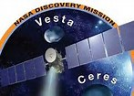
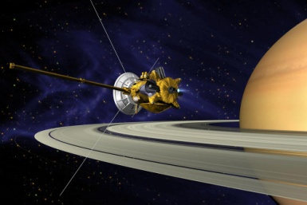
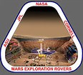
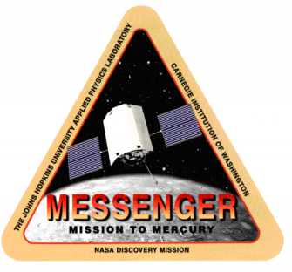
Space Update 2015 Pluto, Ceres, Mars, Cassini & More…
George Gamota January 6th 2016
Notes:
Space exploration in 2015 was an unprecedented series of firsts and major achievements.
But for the US and the world’s space communities, nothing quite captured the spirit and excitement of exploration more than the heralded exploration of Pluto and the detection of the first Earth-like exoplanet orbiting a Sun-like star.
Not since Apollo and the epic space race of the Cold War has space featured so heavily in the public eye as it did in 2015
It took 38 years, but 14 July 2015 finally brought to conclusion NASA’s Grand Tour of the solar system begun by the Voyager 1 and Voyager 2 spacecraft in 1977.
The two crafts together visited all four of the gas and ice giants of the outer solar system, but scientific observations of Titan as well as Uranus and Neptune precluded a visit by either of the spacecraft to the tiny little world on the outer edge of the solar system: Pluto, the 9th planet.
In 2006, NASA set out to explore the Kuiper Belt Object (KBO), and 2015 saw the much anticipated close encounter by the New Horizons spacecraft of Pluto and its five moons.

Slide 2
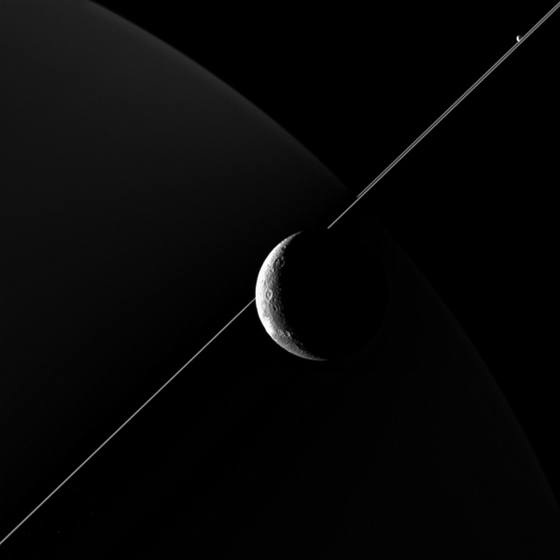
Cassini
Mission Cassini reached Saturn and its moons in 2004. Here is a recent photo of Saturn in the background with a ring. Moon Deane

Slide 3
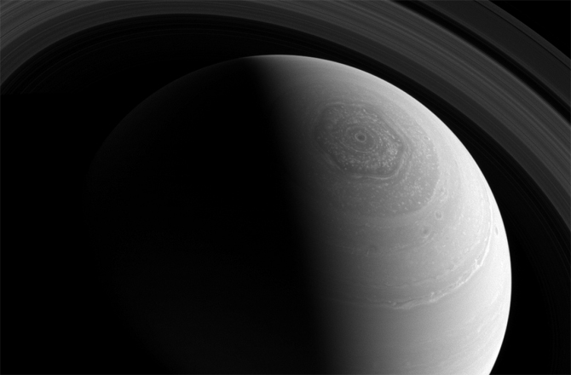
Saturn’s North Pole

Slide 4
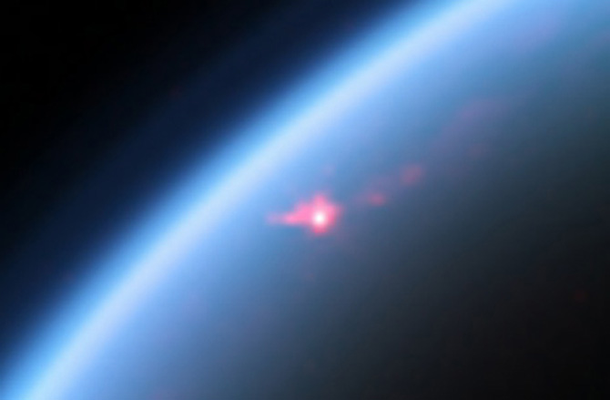
Saturn’s Moon Titan
Notes:
There are few worlds that hold more promise than Saturn's largest moon Titan. The moon is known to have a thick atmosphere, large bodies of liquid methane and ethane, hydrocarbon-rich landscapes filled with rivers and valleys, and vast dune fields. One would be mistaken in thinking this moon is in fact an embryonic Earth, filled with organic potential. It may be frozen and unsuitable for life as we know it, but astrobiologists dream of having a follow-up mission to Titan after seeing the European Huygens lander (which hitched a ride to Saturn on board Cassini) float down and land on the moon in 2005.

Slide 5
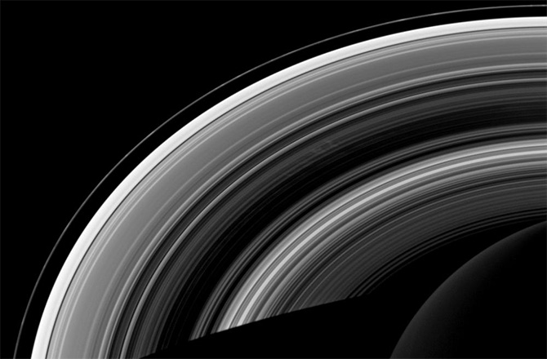
Saturn’s Rings

Slide 6
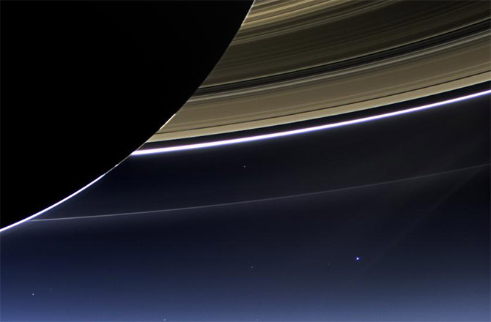
Earth as seen from Saturn

Slide 7
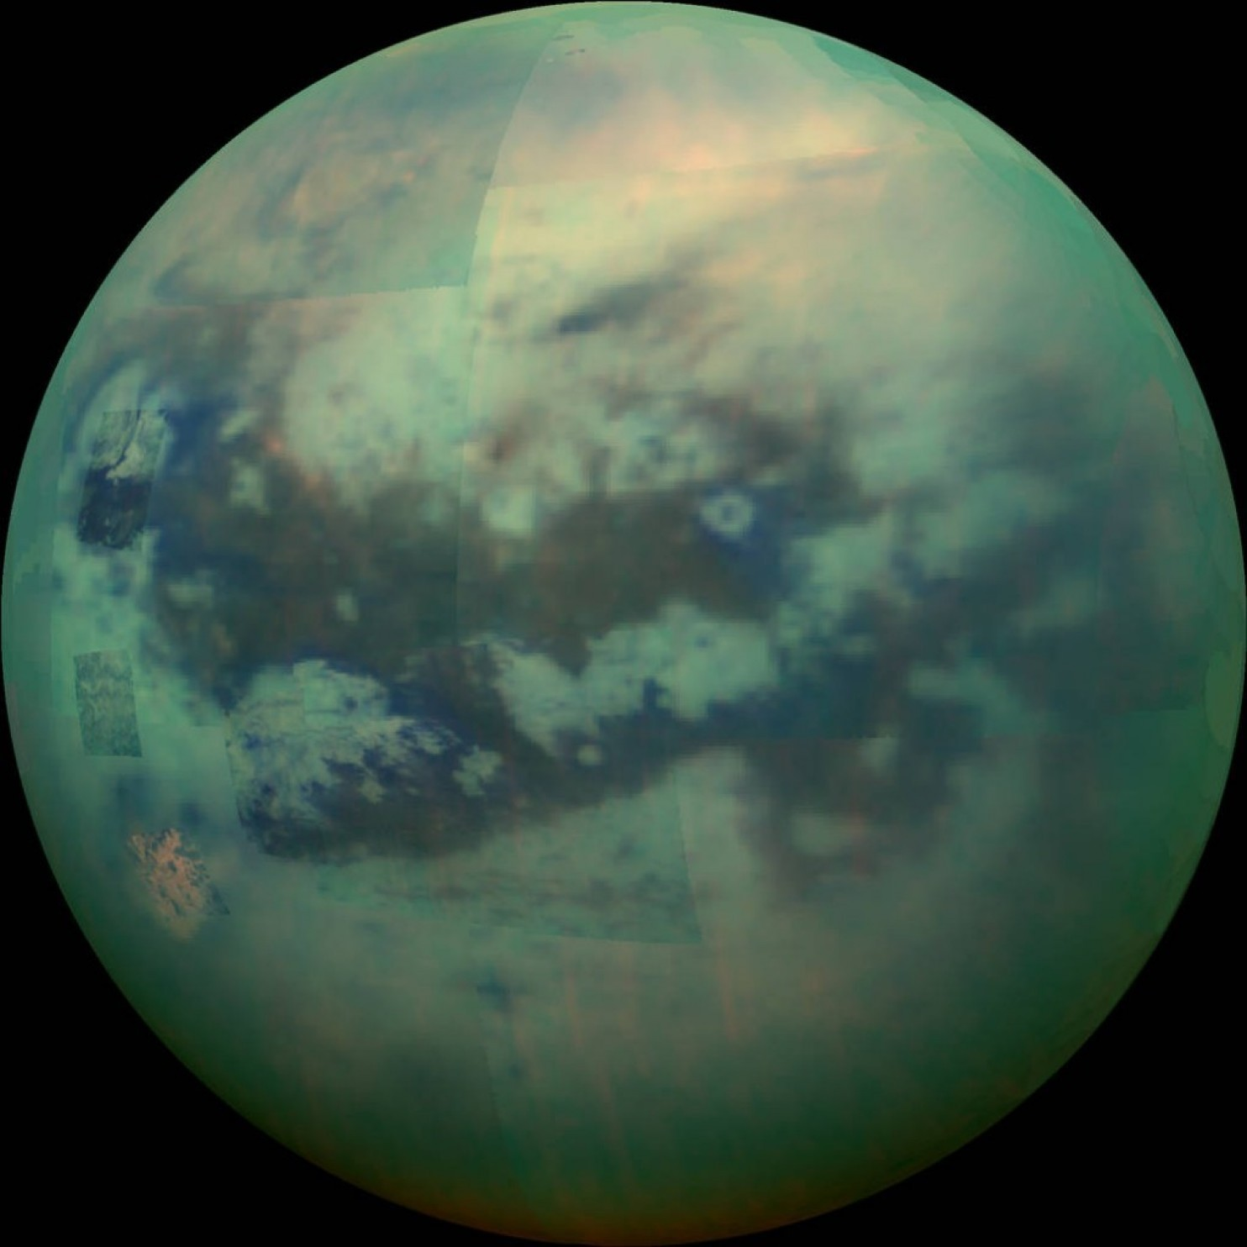
TITAN
Notes:
Titan

Slide 8
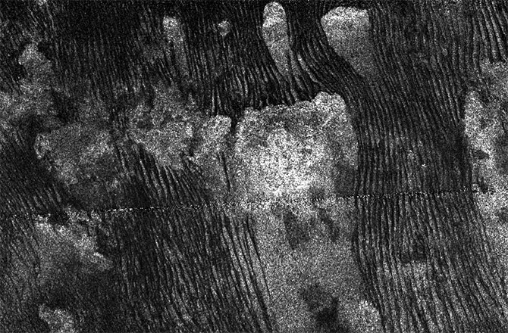
Titan’s Dunes
Notes:
Zooming in on Titan's vast dune fields during multiple flybys, Cassini has shown us even more Earth-like Aeolian (wind-blown) features. In the case of Titan's black dunes, small grains of organic compounds have been blown into rippled 'seas' of their own

Slide 9
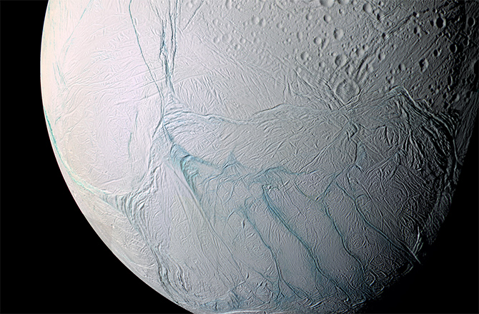
Enceladus
Notes:
The small icy moon of Enceladus isn't only famous for its impressive water-rich geysers that also have hints of life-giving chemistry, there's also the possibility that the moon has extensive sub-surface seas of liquid water. It is almost like a mini-Europa, Jupiter's second-largest moon, and scientists are keen to find out what lies beneath both moons' cracked crust.
During its flybys, Cassini also found that material gushed from warm fractures near Enceladus' south pole. There's also strong evidence for a subsurface sea, which may mean there's a global ocean beneath the moon's icy crust.
With that said, scientists are now examining the images from the close flyby in hopes of better understanding the icy world. It will take a bit more time before researchers can say whether conditions on the icy world are hospitable to life. If they are, though, there could be future missions to the world to test whether or not there are organisms living within this ocean.
After visiting Escalades, Cassini is settling into quiet retirement. The ship will still observe Enceladus from a distance, but its focus is shifting more toward Saturn's outer rings. Eventually, it'll travel to the inner rings and (most likely) crash into Saturn sometime in September 2017

Slide 10
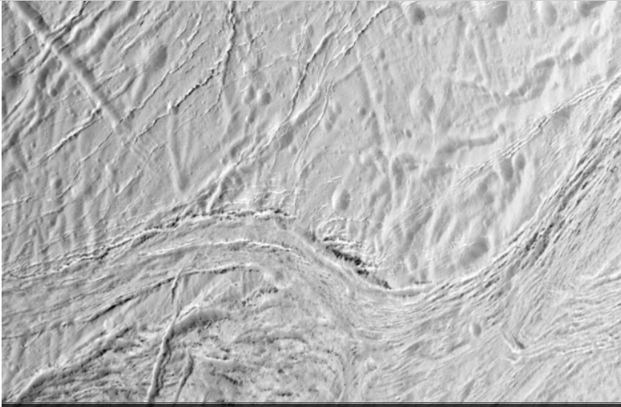
Close-up of Enceladus
Notes:
During its final close flyby of Saturn's moon Enceladus, NASA's Cassini spacecraft captured this view featuring the nearly parallel furrows and ridges of the feature named Samarkand Sulci
Enceladus is Saturn's sixth largest moon and is about 500 kilometers in diameter - less than a sixth the width of our own moon.
Cassini has made its final close fly-by of Enceladus, and the images will be returned throughout the coming year.

Slide 11
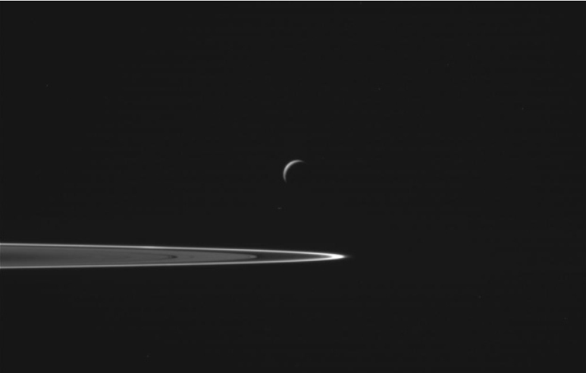
Enceladus and Saturn’s Rings
Notes:
Cassini's final flyby of Enceladus, seen here with Saturn's rings in the foreground, takes place on Dec. 19 at a distance of about 5,000 kilometers, to measure the amount of heat coming from the moon's interior

Slide 12
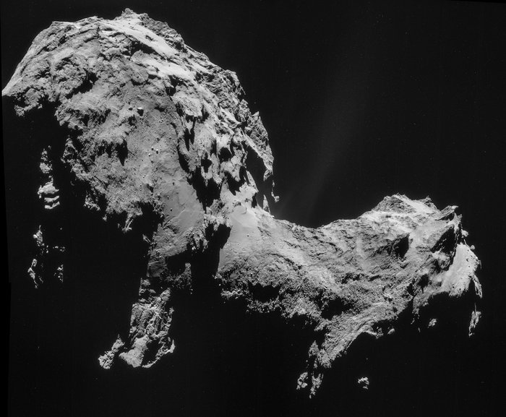
Comet 67P/Churyumov-Gerasimenko
Notes:
The mission to visit and land a probe on a comet was a joint ESA and NASA project.
The idea that there’s a spacecraft is sitting on a comet still astounds me.

Slide 13
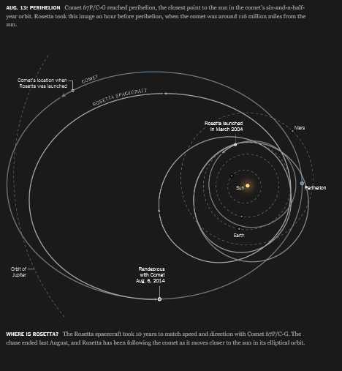
Rosetta Flight Path

Slide 14
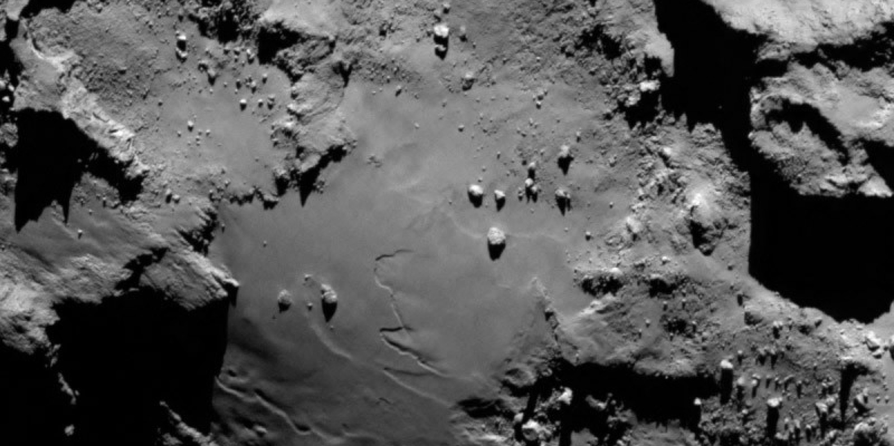
Surface of the Comet
Notes:
The surface of comet 67P/Churyumov-Gerasimenko as viewed at a 10-kilometer distance by navigation cameras

Slide 15
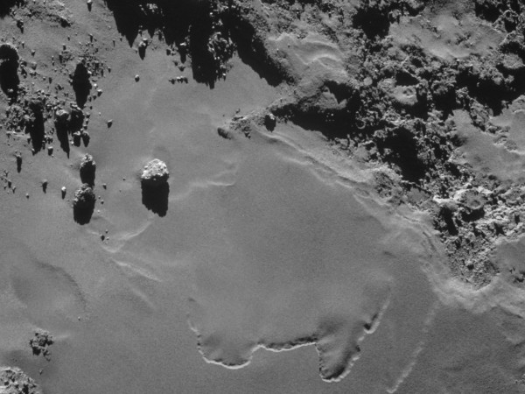
Smooth surface of the Comet
Notes:
The surface of comet 67P/Churyumov-Gerasimenko as viewed at a 10-kilometer distance by navigation cameras
The comet is made of ice and rock and as it gets closer to the sun the ice evaporates.

Slide 16
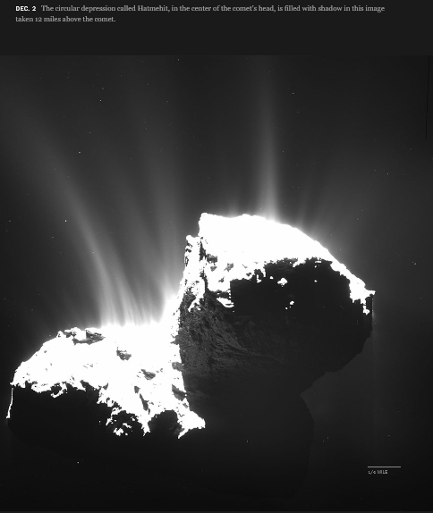
The closer to the sun, the more ice evaporates
Notes:
The lander Philae landed successfully but stopped transmitting when its batteries gave out. Most likely it landed in a valley hidden from the sun. There was hope this year in spring but it never woke up.
That wake up came true (briefly) in 2015 and is a great reason to feature Rosetta again this year and explore the scientific discoveries from the comet, such as how the iconic tail forms from comet ice as well as the discovery of organic material. These compounds are the precursors to several different amino acids as found in organisms on Earth, meaning objects like Comet 67P could have brought the ingredients for life to the planet’s earliest days.
One of the big surprises is that the water in this comet has three times more “heavy” water (where hydrogen is replaced with its heavier isotope deuterium) than in the oceans of Earth. Wherever the water came from that made life possible on Earth it wasn’t from comets like this.
Rosetta will watch 67P’s activity die down as the comet moves further and further away from the sun. But before we say a complete goodbye to comet Churyumov-Gerasimenko, maybe, just maybe, we will hear from Philae…Philae, Rosetta’s intrepid little landing craft that bounced across the surface in November 2014 and was lost in the shadow somewhere on the comet? As the changing illumination lit up Philae’s resting place, giving energy to its starved solar panels, the little lander woke up, communicating with mission control on and off, starting on 13 June. Sadly, what little illumination was present proved insufficient to fully awaken Philae and contact was lost again on 9 July.
Its comet, with the tongue-twisting name 67P/Churyumov–Gerasimenko, made its closest approach (110 million miles) to the Sun, a period known as perihelion when the comet would be expected to be at its most active. Rosetta was there to witness this. It saw great streams of dust and water vapor spewing from the comet’s surface and watched the diurnal (day/night) cycle of ice as it sublimated (evaporated) in the sunshine and refroze in the night-time darkness. Rosetta detected a high-proportion of oxygen so ancient that it dates back to before the Solar System was born, and determined that the comet is actually two comets that have gently come together at the join of the comet’s neck. Rosetta saw the collapse of deep pits and sinkholes hundreds of meters across, from which jets spewed out, causing the occasional commentary outburst.

Slide 17
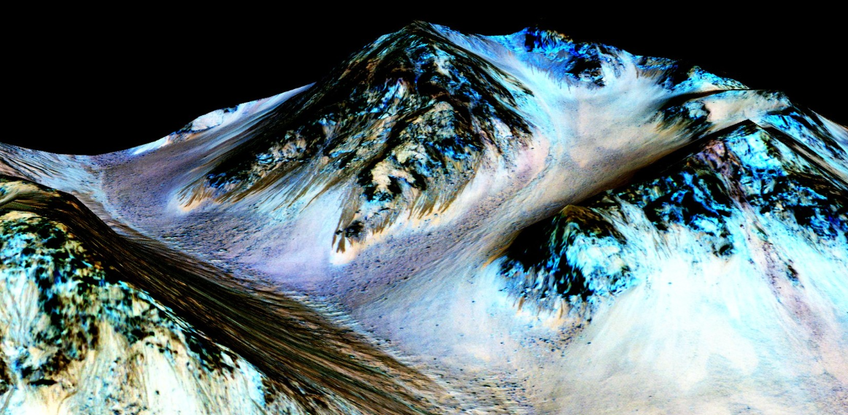
Mars Rovers
Opportunity
Completing a Marathon on Mars
Curiosity
Notes:
The announcement that Mars has flowing water on its barren surface was of huge importance as (at least on Earth), where there’s flowing water, there’s life. It meant we need to reassess the conditions under which water can exist and hence the possibilities for life.
Here is an image of Mount Sharp on Mars a Curiosity gets closer to it.
The red planet made the 2015 list of discoveries because of the incredible discovery by NASA’s MAVEN spacecraft that the Sun was responsible for stripping the Martian atmosphere away, turning a water-rich world nearly four billion years ago into the inhospitable desert it is today.
The atmosphere isn’t locked away in rocks underneath the surface, a la Total Recall, but instead has been lost to space meaning future colonists may well have to bring more of their supplies than thought.

Slide 18
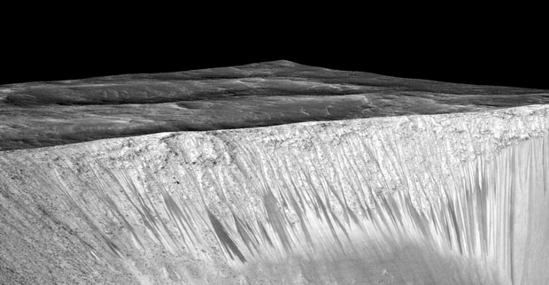
Garni Crater on Mars
Notes:
A simulated topographic image of dark streaks formed by water running down the walls of Garni Crater on Mars. The image is constructed from imagery from the Mars Reconnaissance Orbiter.
Liquid water existing on the surface of Mars, in the here and now, has been the holy grail of Martian exploration for some time, but in October 2015 NASA announced that the orbiting Mars Reconnaissance Orbiter (MRO) had turned water-diviner to find compelling evidence that water is bursting out onto the red surface and trickling down the slopes of crater walls and hillsides. This was exciting news because it raised the chance that life could still exist in some form on Mars.

Slide 19
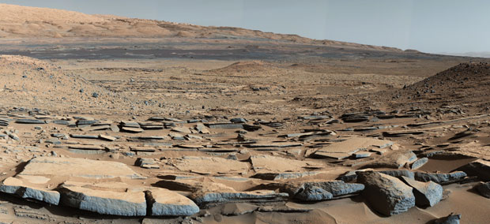
Base of Mount Sharp in Gale Crater
Notes:
Rock strata at the base of Mount Sharp in Gale Crater. In 2015 Curiosity discovered that the bottom 200-metres of the mountain were deposited by a lake, while the rest of the mountain was built up over billions of years by wind-blown dust.
This year has been a successful one for Curiosity, which has completed an assessment of what the environment was like in Gale Crater three-and-a-half billion years ago, finding that it was submerged in up to 200 meters of water for a period of around 500 million years. This discovery was a crucial one in our attempts to understand Mars’ history, for it showed that, long ago, at least some regions on the red planet had climates that were friendly to liquid water, and possibly life.

Slide 20
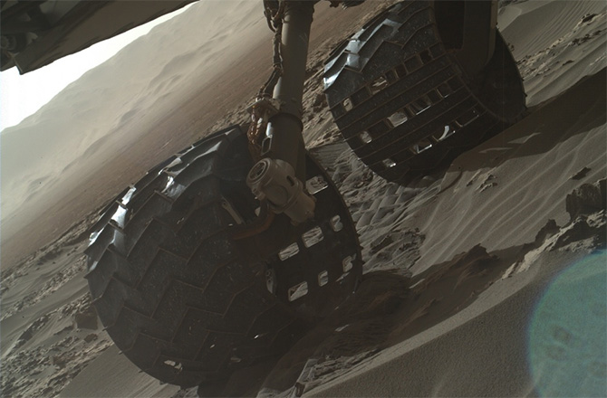
Curiosity’s wheels
Notes:
This observation, snapped by the rover's MAHLI camera, shows Curiosity's right-hand wheels crunching through the sand as the robot rolls onto the dunes on Dec. 3 (Sol 1182).
Curiosity is no stranger to driving across sand, as it demonstrated, quite expertly, in February 2014. Blocking its path up Mount Sharp, and trying to avoid rough landscape to save its wheels from damage, Curiosity was commanded to climb over a sandy dune bridging a small valley called "Dingo Gap." Though there were obvious concerns about the rover becoming stuck in (or atop) the ridge, Curiosity breached the dune and continued with its mission.

Slide 21
Grains of Martian Sand
Notes:
What do you see here? Just some sand?
This could easily be a close-up photo of a tiny patch of beach. Or it could just be a macro image of the grains in a child's sandbox, with bucket and spade just out of shot. But it's neither. Sure, it's sand, but it's Martian sand. Think about that for a moment: We're looking at a microscopic observation of the grains of sand on another planet. Mind-blowing.

Slide 22
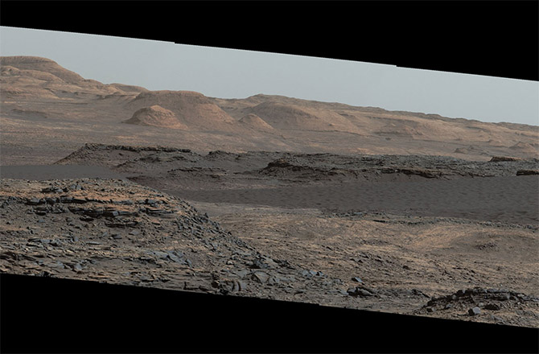
Martian Dunes
Notes:
As Curiosity approached the Bagnold Dunes, mission scientists noted how dark they appeared. This image taken by Curiosity in September shows the dark dunes undulating in front of a pretty craggy series of rocky outcrops. These dunes are known to be active -- in other words, the Martian winds continue to shape them. According to orbital observations of Bagnold, the edges of the dunes are moving at a pace of around 3 feet (1 meter) per Earth year.

Slide 23
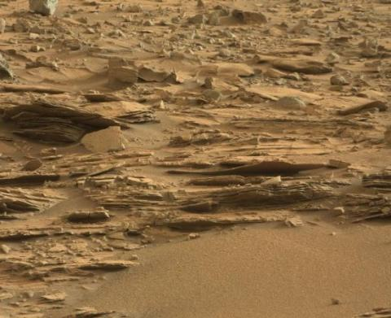
Piles of Silica and Tridymite
Notes:
The silica has been found in high concentrations. Adding to that, Curiosity has also found a mineral, which is even very rare on earth and never seen before on Mars, the space agency added. The mineral named tridymite has been discovery by the rover while drilling into a rock called ‘Buckskin’.
Jens Frydenvang from Los Alamos National Laboratory and the University of Copenhagen said the discovery is surprising because presence of silica is linked to water. On our home planet, high levels of silica are associated with environments that support microbial life, Frydenvang explained.

Slide 24
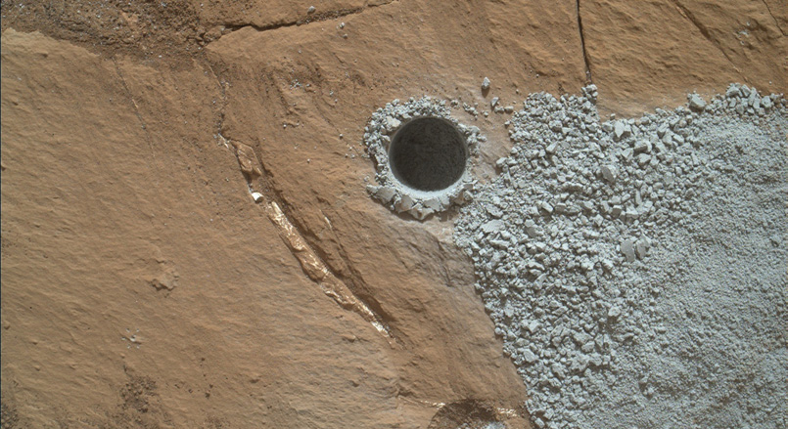
Drill hole and Silica
Notes:
Silicon is one of the most abundant elements on Earth, but we hadn’t detected high concentrations of silica minerals on Mars until seven months ago, when Curiosity approached “Marias Pass,” a contact zone between two Martian rock units located near the base of Mount Sharp. It was here that the rover’s laser-firing ChemCam instrument first ID’d sediments chock full of silica, with concentrations of up to 90 percent. The discovery was so surprising that Curiosity’s science team made the rare decision to turn the rover around and hunt for more.

Slide 25
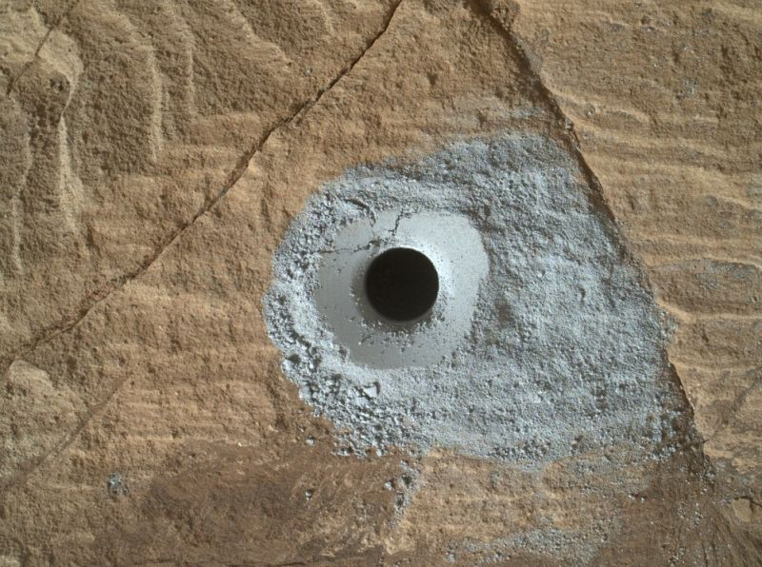
9th Hole on Mars

Slide 26
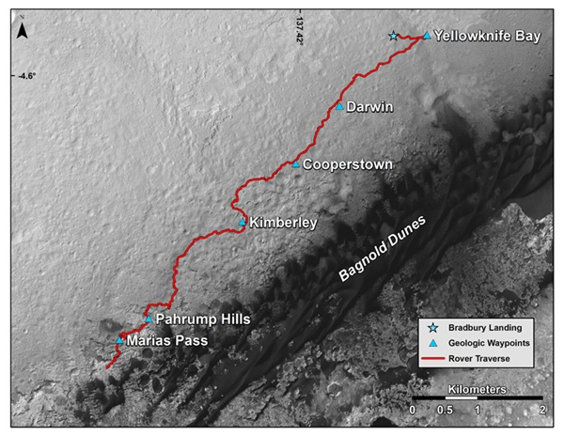
Curiosity on Mars

Slide 27
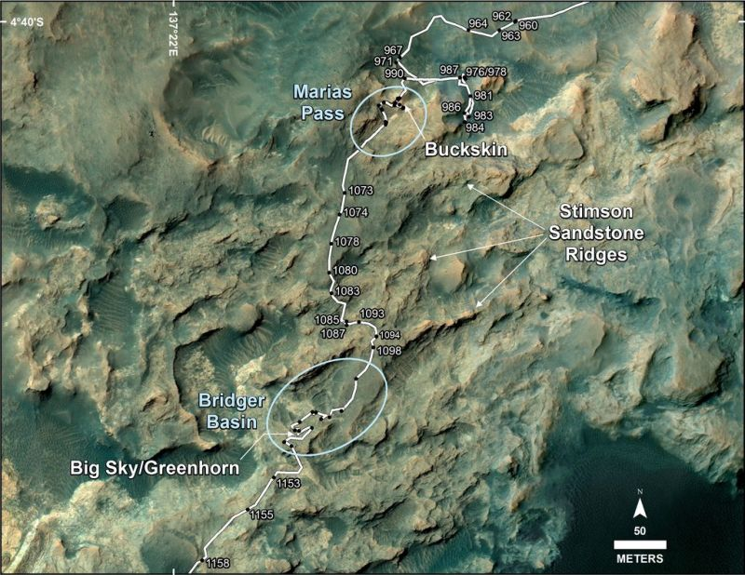
Marias Pass
Notes:
Route on lower Mount Sharp that Curiosity followed between April and November 2015, while investigating silica-rich rock targets, first in Maria Pass, and later in the Bridger Basin area. Image Credit: NASA/JPL-Caltech/Univ. of Arizona

Slide 28
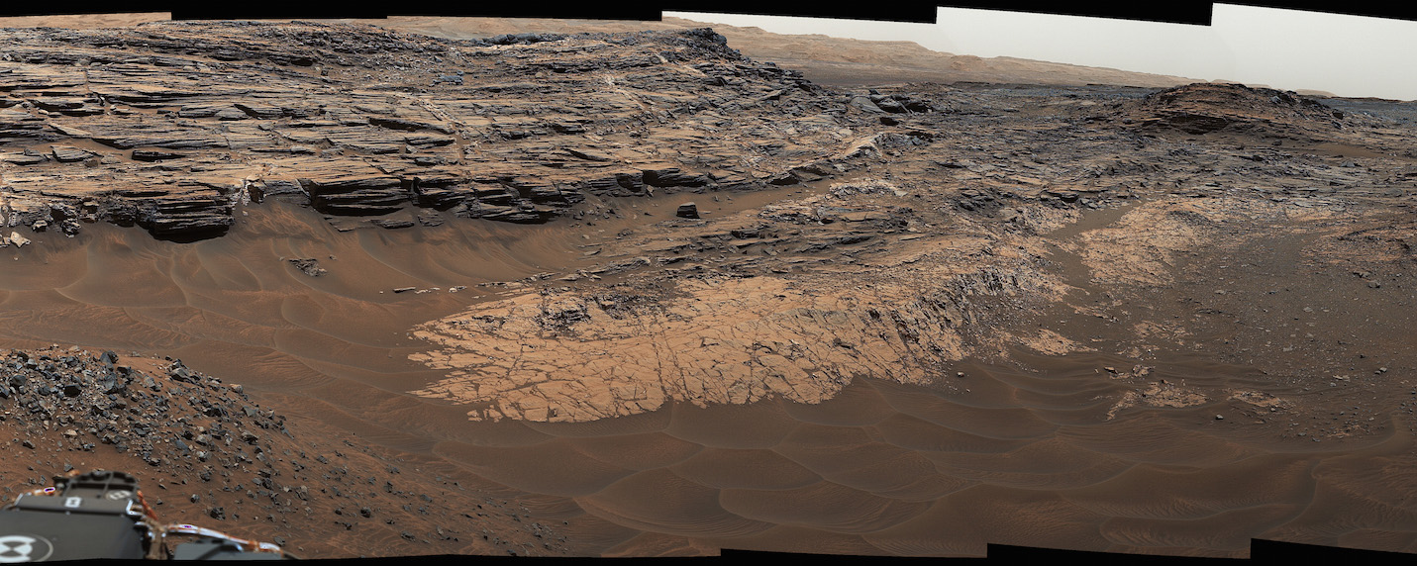
Marias Pass
Notes:
May 22nd, 2015 view from the Curiosity Rover’s Mastcam showing the Marias Pass, an area where a lower, older geologic mudstone unit makes contact with an overlying sandstone

Slide 29
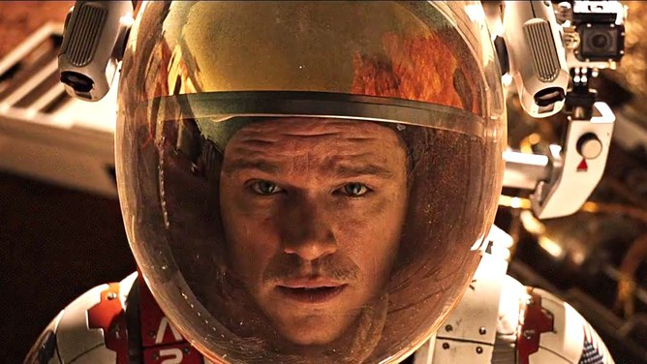
Martian
Notes:
Rarely does a film convey the science so well that it could be considered an educational resource, but The Martian managed it.
Exceptionally detailed consideration of the physics of orbital dynamics, life support systems, astro-biology and some poignant moments of the cost of space exploration to astronauts as much as their families left behind.
The initial sandstorm was more plot device than physical reality, as while global sandstorms occur, the air pressure is so low on Mars (and we now know why thanks to discovery 2 above) that a few air molecules at hurricane speed would only feel like a light breeze in the denser air of Earth.

Slide 30
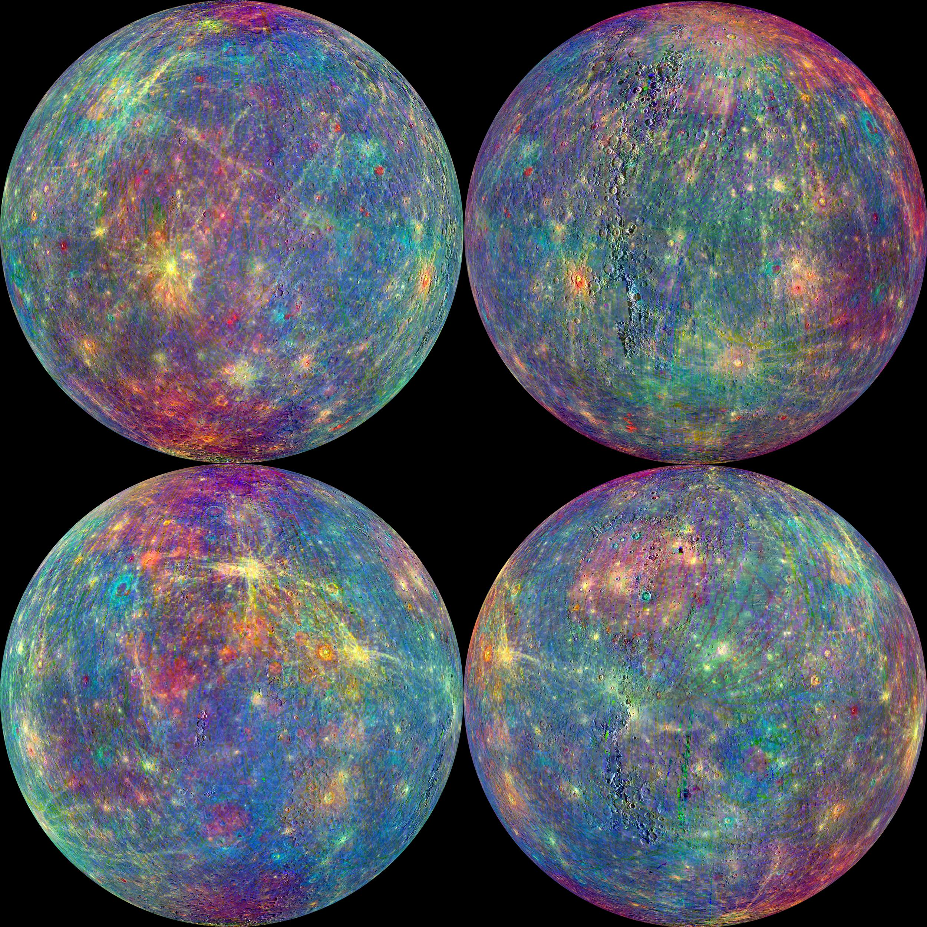
Mercury Examined
Notes:
The MESSENGER spacecraft is the first ever to orbit the planet Mercury, and the spacecraft's seven scientific instruments and radio science investigation are unraveling the history and evolution of the solar system's innermost planet. In the mission's more than four years of orbital operations, MESSENGER has acquired over 250,000 images and extensive other data sets. MESSENGER's highly successful orbital mission is about to come to an end, as the spacecraft runs out of propellant and the force of solar gravity causes it to impact the surface of Mercury near the end of April 2015.

Slide 31
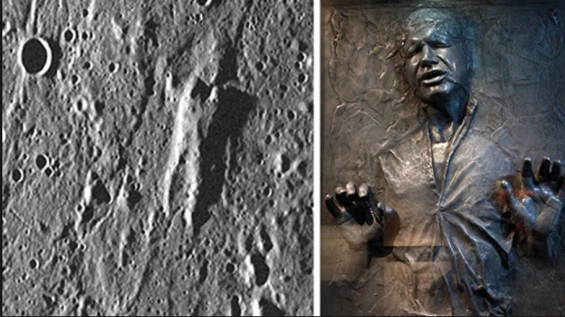
Hans Solo on Mercury?

Slide 32
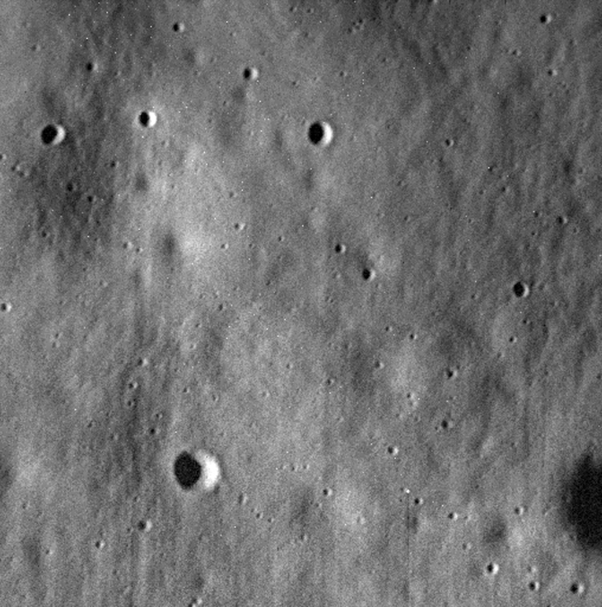
Last photo from Messenger as it crashed into Mercury several hours later
Notes:
One of the biggest challenges of the MESSENGER mission was getting the spacecraft into orbit around Mercury. Because the planet is so close to the sun, there was a risk that the spacecraft would get pulled into the sun, rather than go into orbit around Mercury. Engineers also had to deal with the issue of high temperatures and pull of gravity by the sun.
MESSENGER was designed with a protective sunshield to keep the side of the spacecraft facing the sun cool. The engineers also designed large elliptical orbits around Mercury that allowed the spacecraft to spend time far from the planet in each orbit and cool off. The Messenger probe was launched from earth in 2004, arriving near Mercury in 2008 and orbiting since 2011. Between 2011 and 2015, MESSENGER completed over 4,000 orbits of the planet.

Slide 33
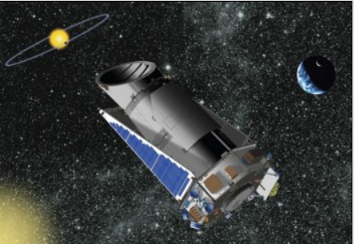
The Beyond - Exoplanets
Notes:
For centuries, scientists understood that it was impractical and statistically impossible that our solar system was the only one to harbor planets.
However, proving that other worlds actually existed was a technological impossibility for centuries until ground- and space-based telescopes finally became powerful enough to detect these other worlds via two tried and true methods of detection: transit and radial velocity.
The first exoplanet was finally discovered in 1992.
From there, the list of confirmed exoplanets grew slowly until the launch of NASA’s Kepler Space Telescope in 2009 and a concerted effort to increase the capability of ground-based telescopes to make the minute observations of distant stars needed to detect exoplanets.
From 1992 to 2009, the total number of confirmed exoplanets stood at just a few dozen.
Following the launch of Kepler, that number skyrocketed to 1,056 planets in 802 planetary systems, 175 of those being multiple-planet systems by the end of 2013.

Slide 34
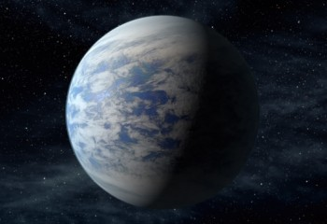
Kepler-452b
Notes:
As of 17 December 2015, according to NASA, the total number of confirmed exoplanets now stands at 1,918 planets across 1,288 planetary systems with 479 multiple planet systems discovered – and an outstanding 4,696 additional exoplanet candidates identified by Kepler still awaiting confirmation.
The quest to find an Earth-like planet orbiting a Sun-like, G-type star continued to remain elusive.
But that all changed on 23 July 2015 when NASA announced the discovery of Kepler-452b – a potentially rocky super-Earth planet orbiting a Sun-like star completely inside that star’s habitable zone.

Slide 35
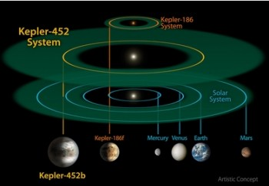
Kepler-452 System
Notes:
The discovery of Kepler-452b in a planetary system approximately 1,400 light years distance in the constellation Cygnus represented the first potentially rocky super-Earth planet around a star very similar to the Sun – a Type G2 Main Sequence star.
While Kepler-452b is not the most Earth-like planet known – it is in fact the sixth-most Earth-like exoplanet known to date on the Earth Similarity Index – the announcement was groundbreaking nonetheless.
Numerous observations of Kepler-452b (its name derived from its parent star’s astronomical designation, Kepler 452, with a lowercase “b” indicating that it is the first planet discovered orbiting that star) revealed that the exoplanet takes 385 Earth-days to orbit its star – compared to Earth’s 365.25 day orbit of the sun.

Slide 36
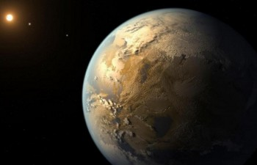
Kepler-452b
Notes:
Kepler-452b is approximately 4.5-6 billion years old, placing it at either the same age as Earth or 1.5 billion years older than Earth, and orbits a star that is approximately 6 billion years old – 1.5 billion years older than the Sun.
The planet is 1.6 times the size of Earth and 5 times Earth’ mass – meaning that if Kepler-452b is terrestrial, its surface gravity would be twice that of Earth’s sea-level.
But whether Kepler-452b is terrestrial is still unknown.
Scientists think there’s a “better than even chance” that Kepler-452b is terrestrial. But it could also be a small Neptune-like planet.
Therefore, at this point in a Type G2 star’s evolution and at Kepler-452b’s distance from its star, the planet would be receiving 10% more energy than Earth currently receives.
Thus, if Kepler-452b is terrestrial, it’s likely experiencing or very close to experiencing a runaway greenhouse effect, like Venus.

Slide 37
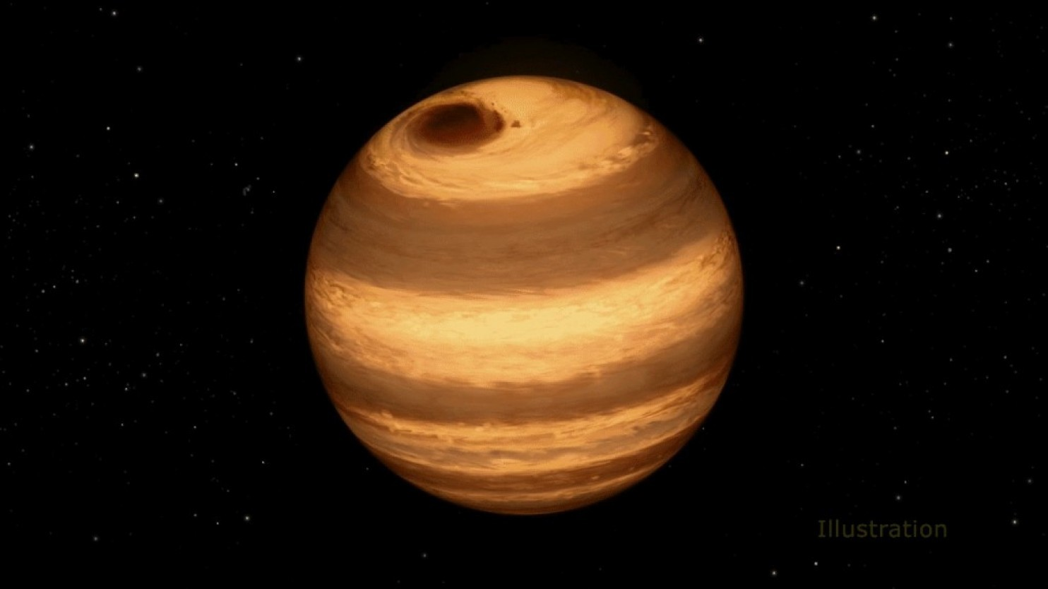
And there is…
Notes:
From Hubble: cool star, called W1906+40, marked by a raging storm near one of its poles

Slide 38
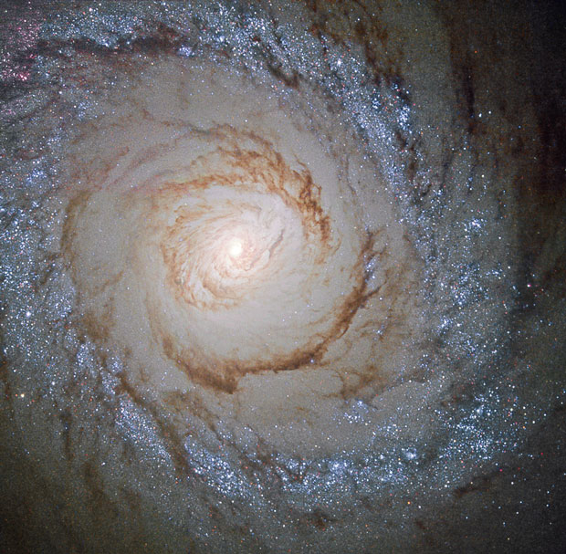
Spiral Galaxy forming Stars
Notes:
The spiral galaxy M94, imaged by the Hubble Space Telescope in 2015, is still forming stars, but in many other galaxies star formation has stopped. Scientists don’t know why this is happening but proposed two alternate theories.
This might be a good topic for a future talk.

Slide 39
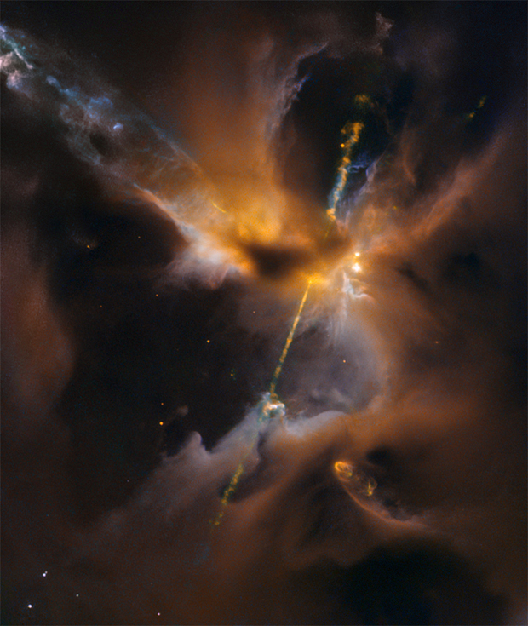
Real life “Star Wars” lightsaber in our galaxy Hubble shows superheated jets shooting outward from the birth of a star 1,350 light-years from Earth

Slide 40
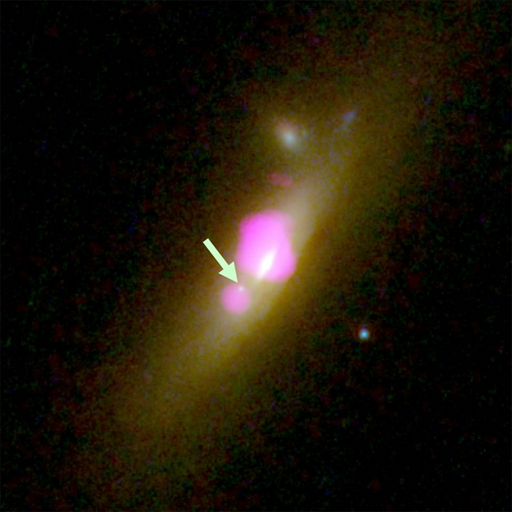
Two Black Holes Merging
Notes:
And Finally for 2015:
An image that combines data from the Hubble Space Telescope and the Chandra X-ray Observatory shows a galaxy harboring two black holes, both marked by light emitted from material that is heated as it is accelerated. The hole on the left, marked by an arrow, may be a rare intermediate-mass black hole. A larger hole lurks at the center of the galaxy to the right, embedded in a rich swarm of stars.
Galaxies in the process of colliding and merging are not uncommon, but detecting and studying two post-merger black holes in the relatively brief period (100 million years or so) before they coalesce into a single supermassive hole is a major challenge. One such galaxy comes with an added bonus, an astronomer said Tuesday: a rare, possible intermediate-mass black hole.
Supermassive black holes are thought to lurk in the cores of all large galaxies, containing the mass of one million to one billion or more suns. The mass of the hole is proportional to the mass of the galaxy and when galaxies merge, their black holes merge as well, generating gravitational waves in the fabric of spacetime.
Galaxies "merge all the time, but this phase where the two black holes are separated doesn't last that long geologically speaking.

Slide 41
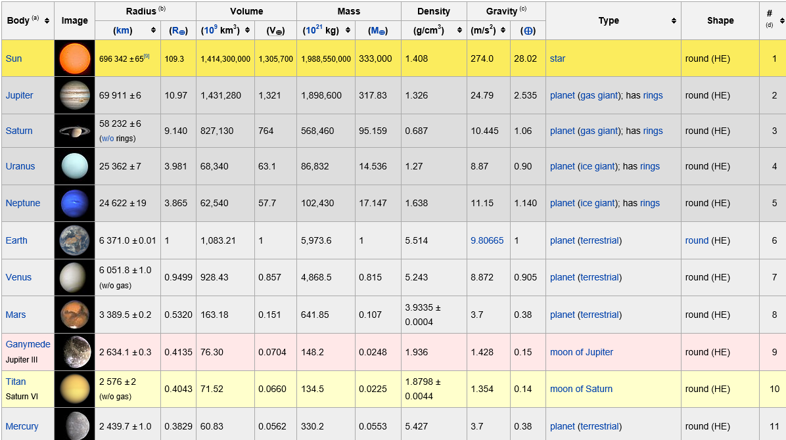
Solar System Objects (1)

Slide 42
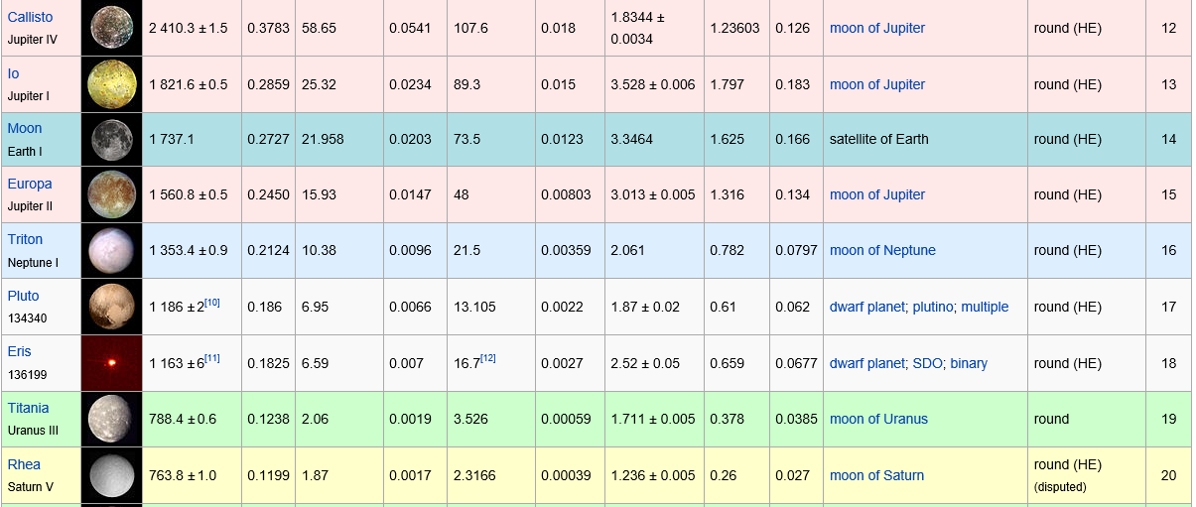
Solar System Objects (2)

