Slide 1
Robots, AI and the Economy
Peter Albin
Lexington Computer Group
July 26, 2017

Slide 2
Robots, AI and the Economy
Are robots part of our lives?
Domestic Robots
Bringing robots into the Home
Boston Dynamics
Amazon
Robotics, AI and the Macro-Economy
Other Uses for Home Robots

Slide 3
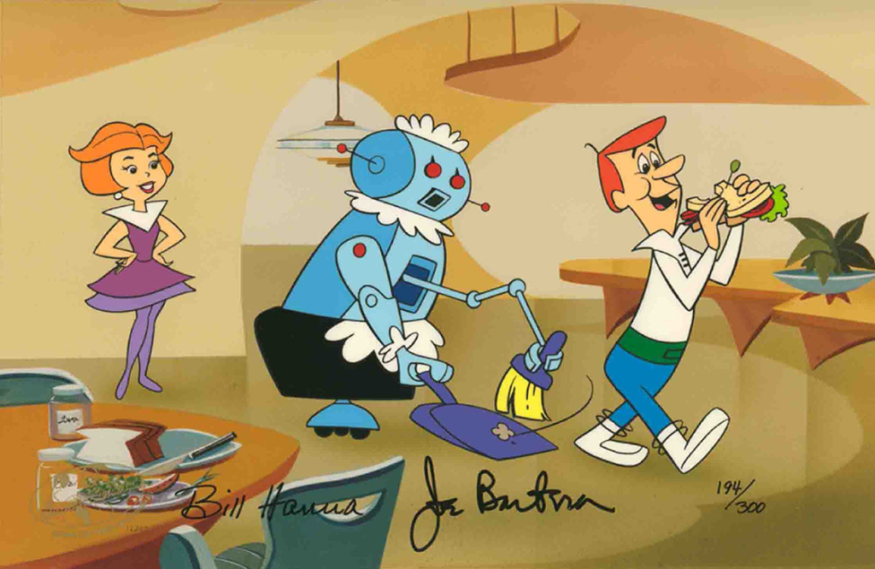
Are robots part of our lives?

Slide 4
Domestic Robots
Domestic Robots - The Future In Real Life
Engadget
https://www.youtube.com/watch?v=bg7-3A2zeyw
Notes:
7:15

Slide 5
Bringing Robots into the Home
iRobot’s CEO on bringing robots into the home
TechCrunch
https://www.youtube.com/watch?v=lv4ul2sjTiE
Notes:
3:13

Slide 6
Boston Dynamics
The CEO of Boston Dynamics explains each robot in the fleet
TechCrunch
https://www.youtube.com/watch?v=_JRV2Z1mr7M
Notes:
2:59

Slide 7
Amazon Robots!
Stephen Hawking's Presents … Amazon Robots!
Stephen Hawking's Presents…
https://www.youtube.com/watch?v=i0fEiw4ycyY
Notes:
6:44

Slide 8
Robotics, AI, and the Macro-Economy
Robotics, AI, and the Macro-Economy |
Jeffrey Sachs
Future of Life Institute
https://www.youtube.com/watch?v=d8tlyFOq2tU
Notes:
40:33

Slide 9
Other Uses for Home Robots
Roomba Pong with Magic Johnson and Luke Wilson
The Tonight Show Starring Jimmy Fallon
https://www.youtube.com/watch?v=rCmAijhFPrc
Notes:
2:12

Slide 10
Comments?
Questions?
Demo?

