Slide 1
Agenda 10/14/2015
How to create a Windows 10 install disk using Microsoft Media Creation Tool
How to create an image file using Acronis True Image (and a built in alternative)
How to clone a disk using Acronis True Image (or EZ Gig IV)

Slide 2
Microsoft Media Creation Tool
Go to: http://windows.microsoft.com/en-us/windows-10/media-creation-tool-install
Click on “Download the Tool”, then “Software Download Page”

Slide 3
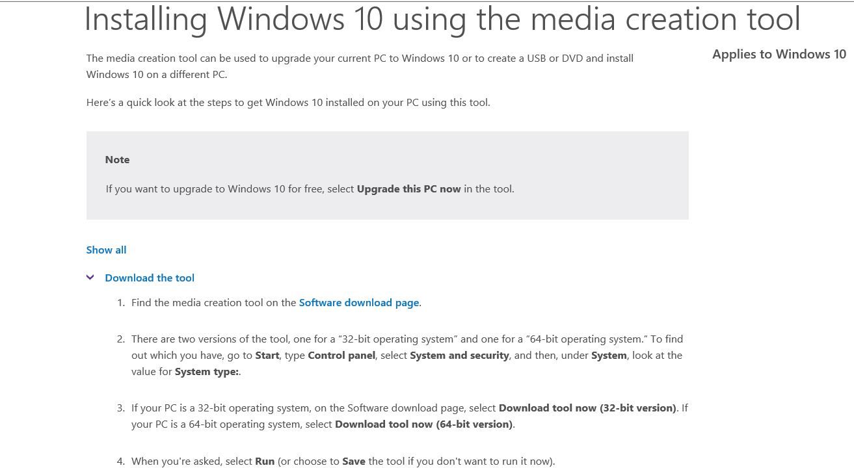

Slide 4
Select 32 or 64 bit as appropriate and click “Download Tool Now”
We will be saving the installer, NOT upgrading this PC now
When you click on “Download Tool Now”, you be asked to Save or Run.
Select Run

Slide 5
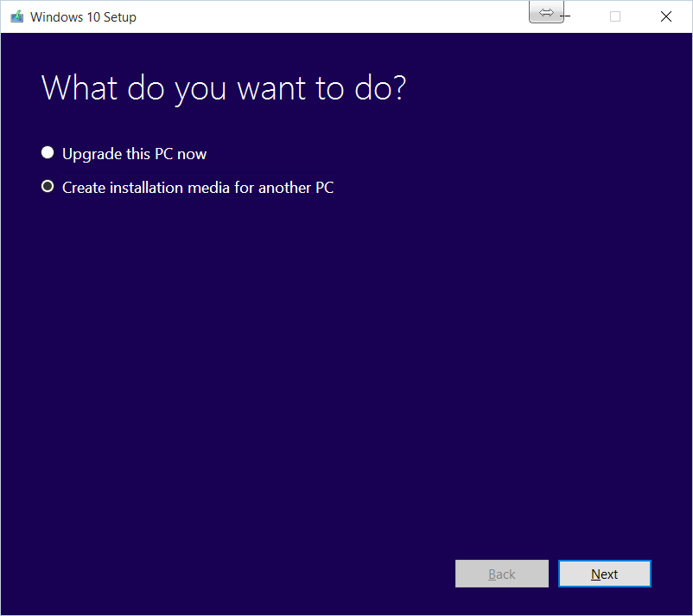

Slide 6
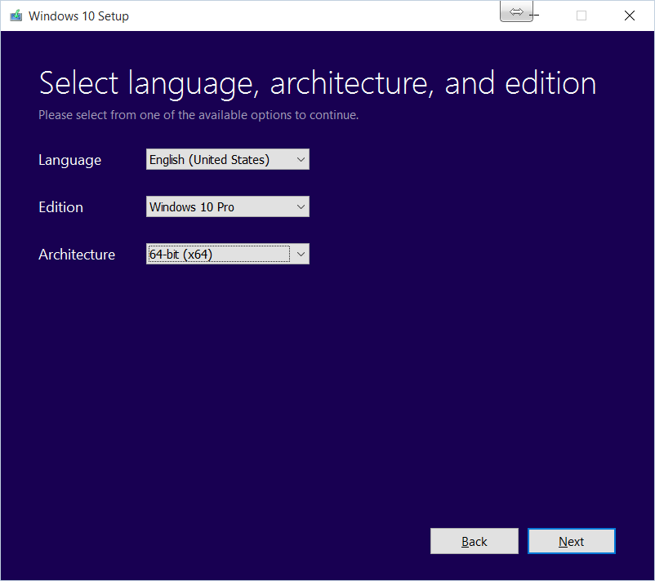

Slide 7
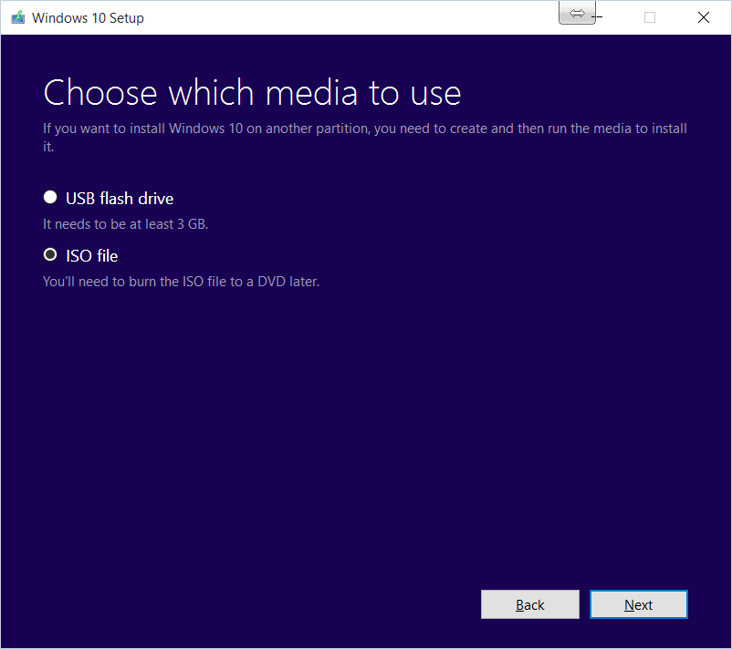

Slide 8
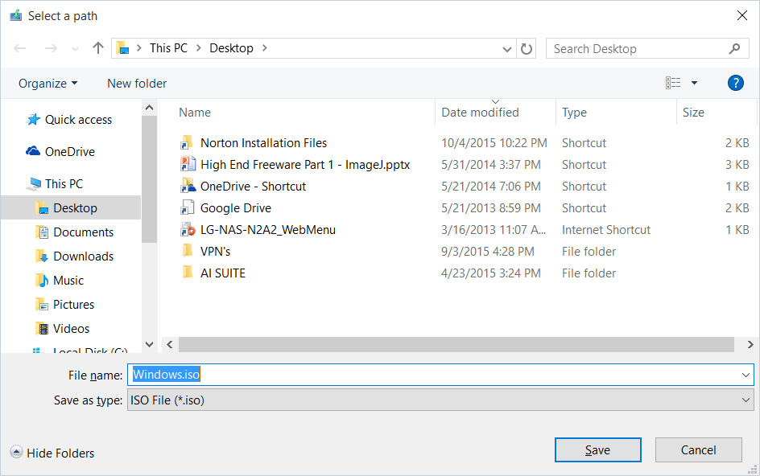

Slide 9
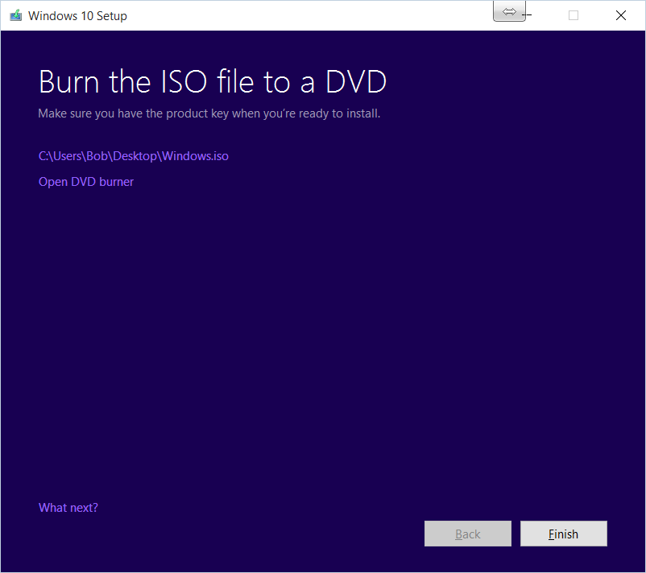
Took 12 minutes to download on 75 Mbit / sec FIOS

Slide 10
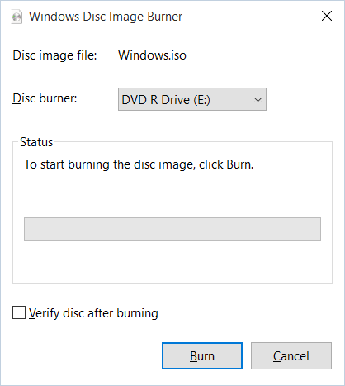
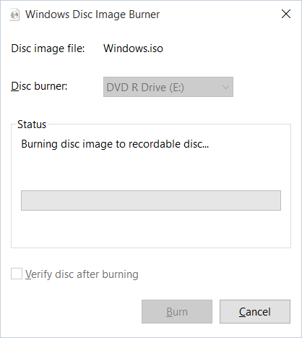
Open DVD Burner

Slide 11
How to create a disk image
What is it?
A bit by bit map of the drive that can be restored to another drive resulting in a clone
Why?
Quick way to restore PC in the case of:
Boot disk failure
OS upgrade gone bad
Dislike of new OS, etc.
How?
Acronis True Image
Cost $79.99 / 3 PC; $49.99 / 1 PC

Slide 12
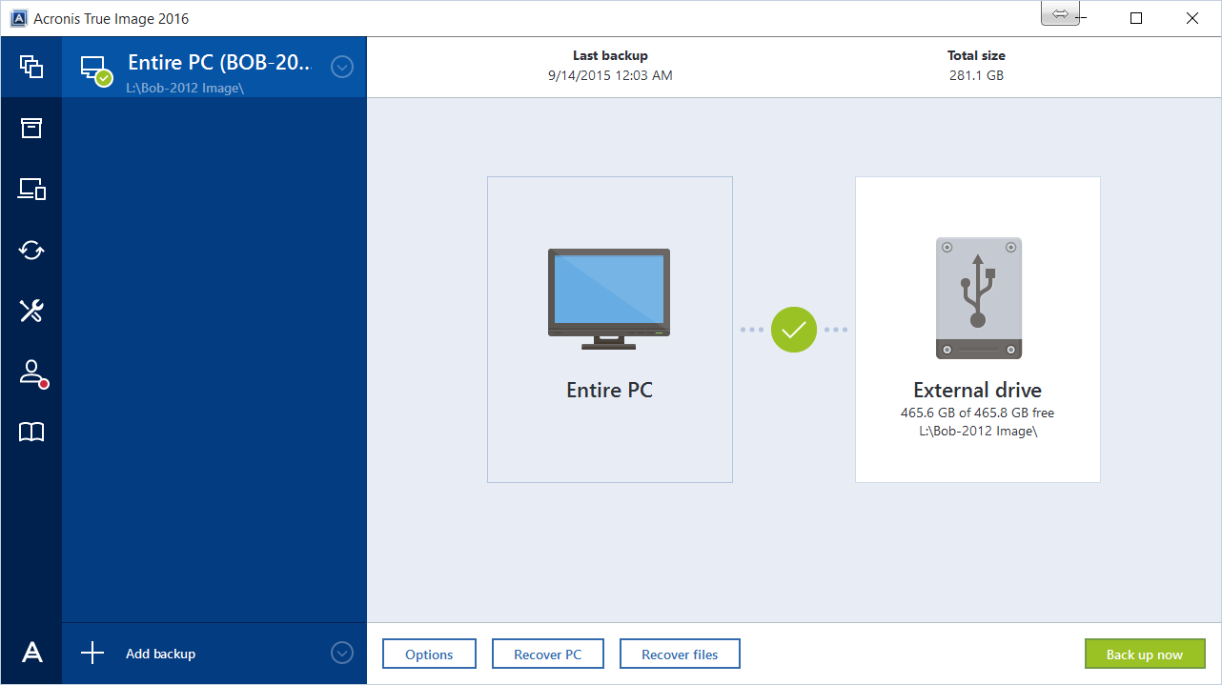
Select path for image file
Then click “Back up now”

Slide 13
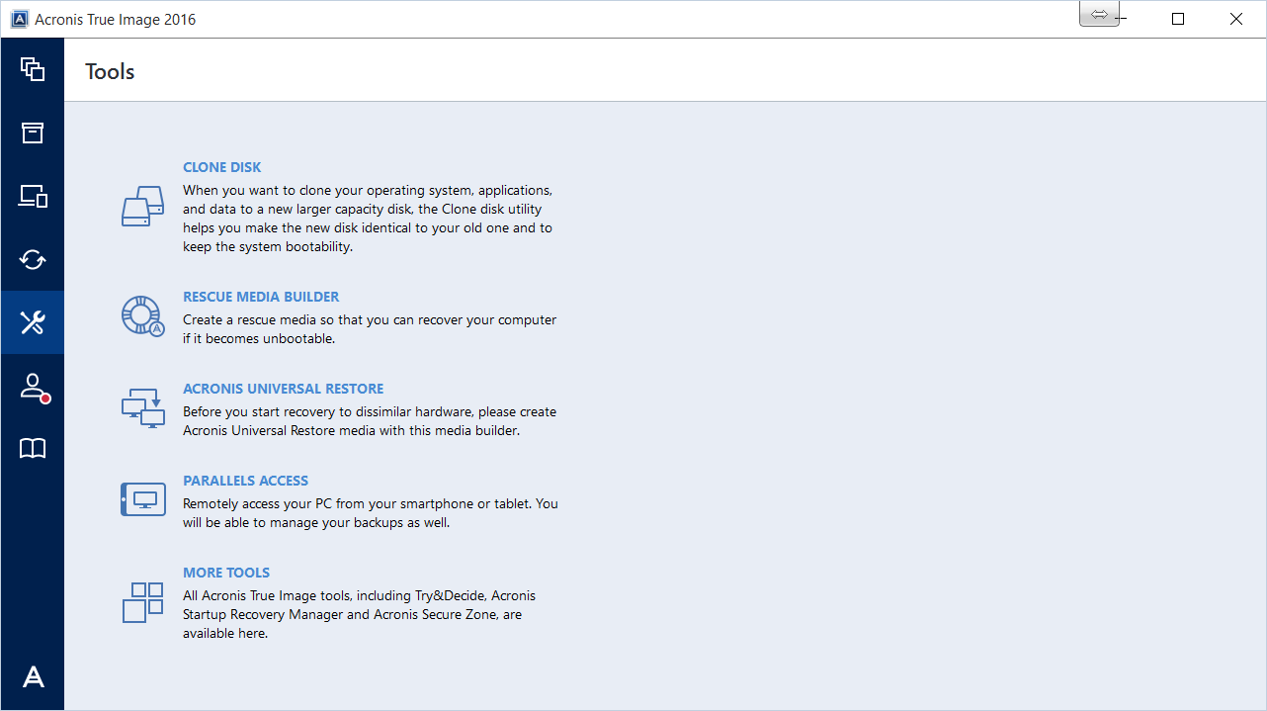
To restore a crashed PC, you must have prepared a rescue disk
This option is found under the tools icon:

Slide 14
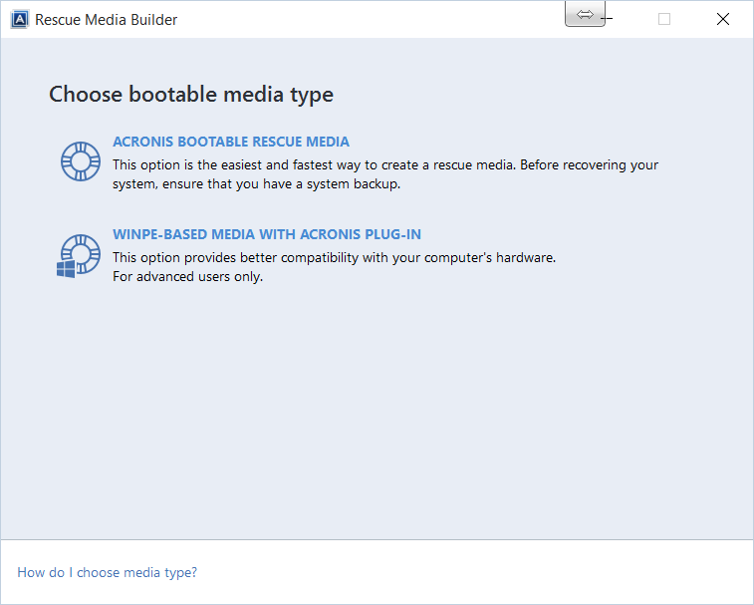
Select Acronis Bootable Rescue Media

Slide 15
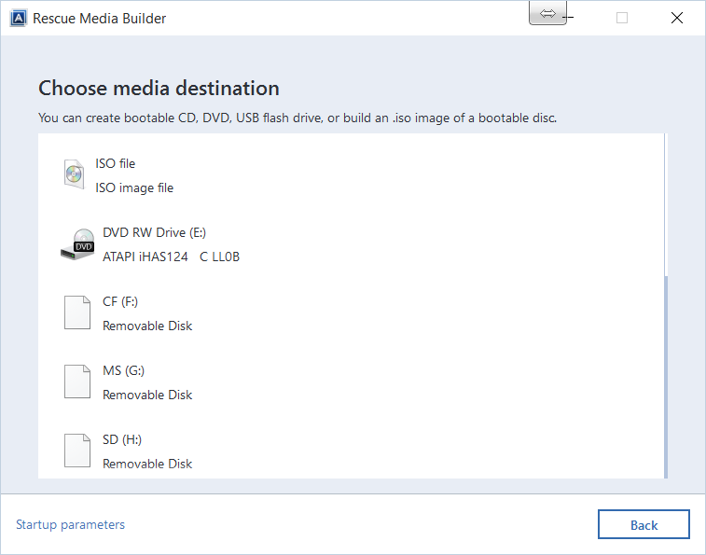
Select destination

Slide 16
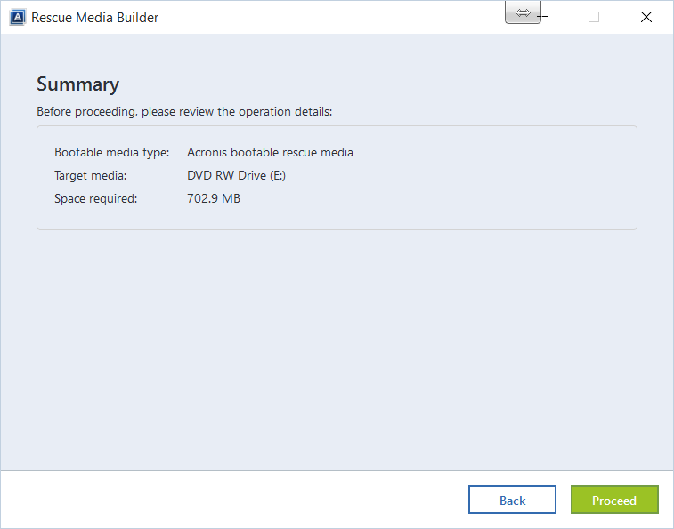
Click Proceed

Slide 17
Image file creation alternative
Built in utility
Buried in sub-sub menu of non-obvious location
Reference:
http://www.cnet.com/how-to/how-to-create-a-system-image-in-windows-10/

Slide 18
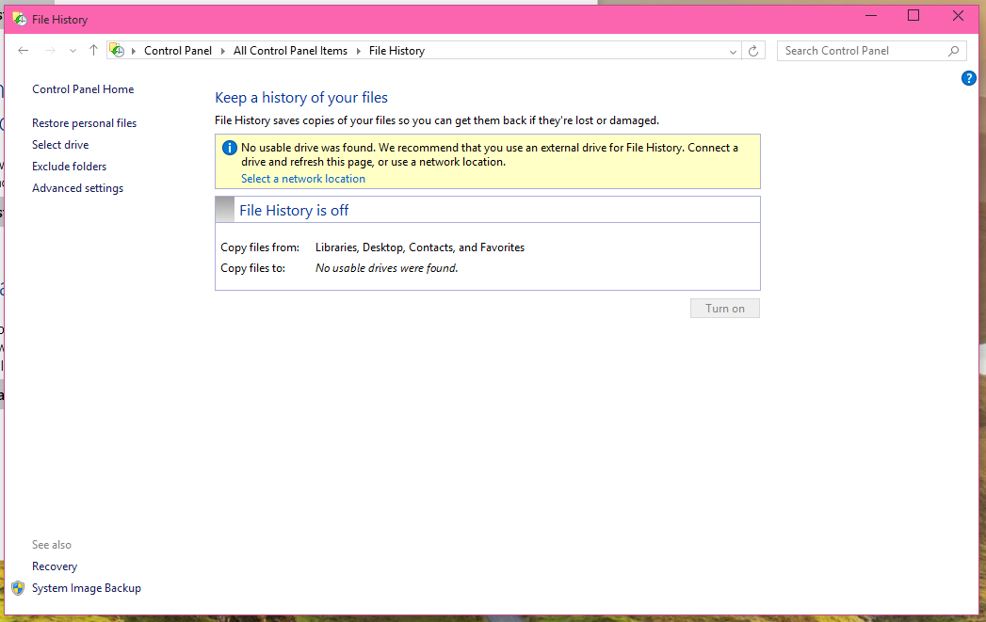
Windows 10 Disk imaging utility
1. Open Control Panel and go to File History. (right click on start button and select Control Panel)

Slide 19
Windows 10 Disk imaging utility
The System Image Backup utility will open. Pick a place to save your system image backup (on a hard disk, on one or more DVDs, or on a network location), and click Next. Confirm your settings and click Start backup.
To use your system image to restore your PC, open up the new Windows 10 Settings menu and go to Update & recovery. Under Recovery, find the Advanced startup section, and click Restart now. When your PC restarts, go to Troubleshoot, Advanced Options, and then choose System image recovery.

Slide 20
Windows 10 Disk imaging utility
If computer is unbootable, use Windows 10 install disk and follow these directions:
https://www.winhelp.us/restore-a-system-image-in-windows-7.html
The above link has directions for Windows 7, 8, and 10
If doing this, DO NOT install, select “Troubleshoot”

Slide 21
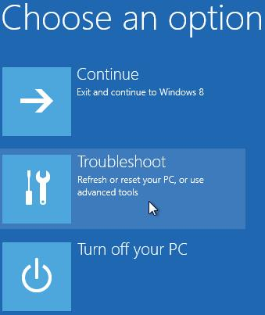
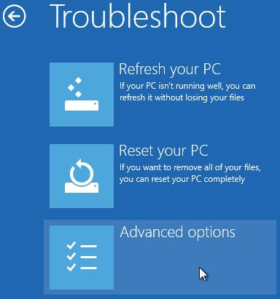
This will lead to:

Slide 22
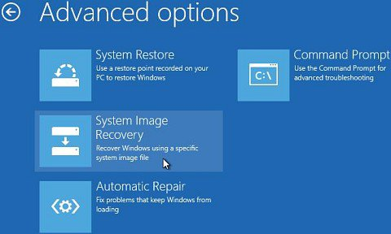
And then to:
You now have the opportunity to locate, select, and load the image file

Slide 23
How to clone a disk
For hard drive replacement / upgrade
Connect new drive to SATA / USB adapter
If using Apricorn DriveWire adapter, then can use their EZ Gig IV freeware
EZ Gig IV is the drive cloning subset of Acronis True Image, and has a very similar user interface
http://www.apricorn.com/products/software/ezgig.html

Slide 24
Example using Acronis True Image

Slide 25
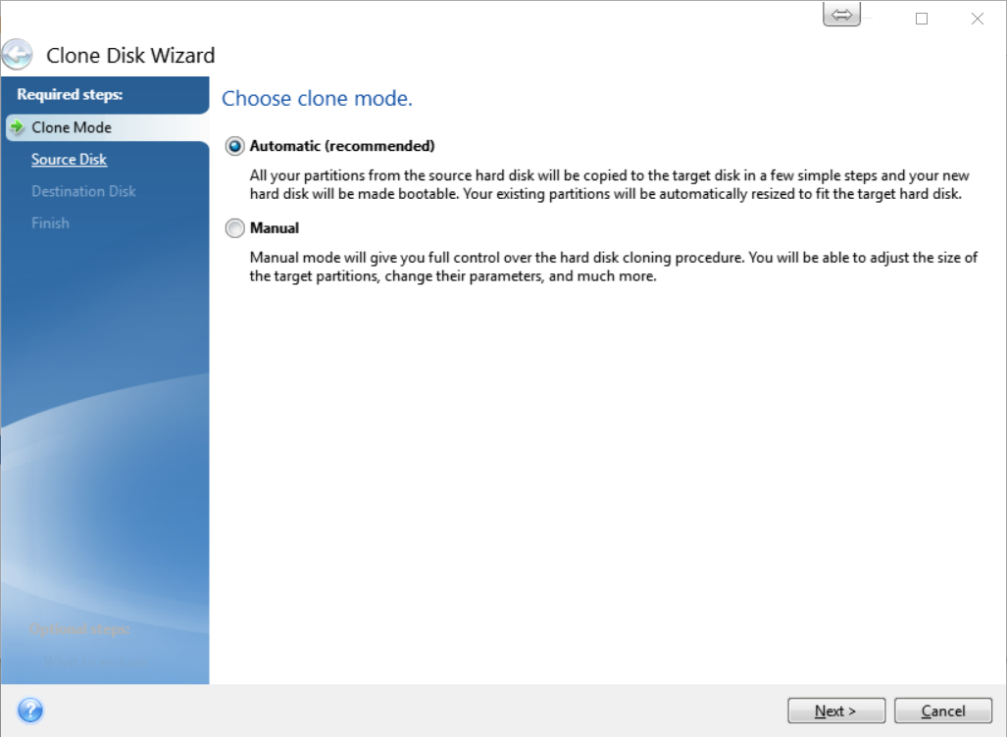

Slide 26
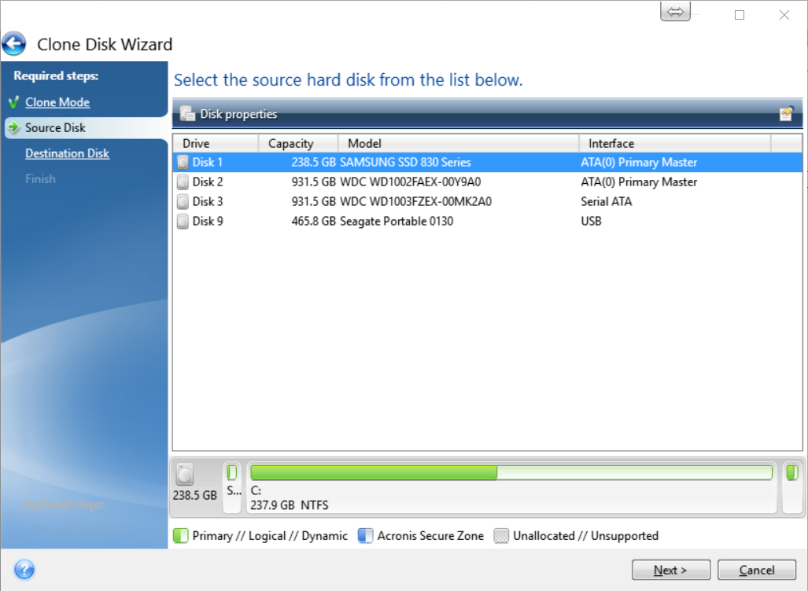

Slide 27
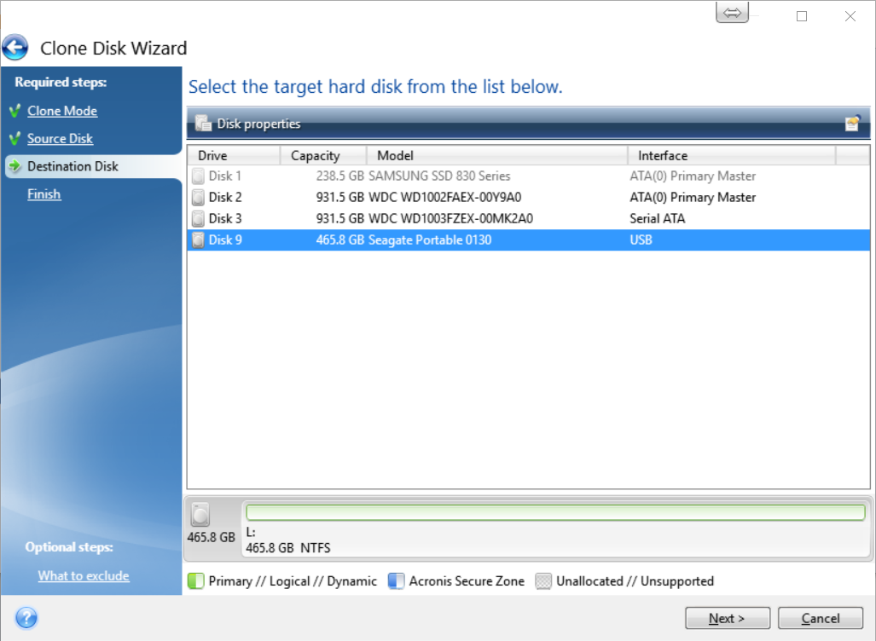

Slide 28
CAUTION!!!
At this point, make very sure that source and destination are correct!
It is possible to erase your C:\ drive if you clone a blank disk to the C:\ drive!!!

Slide 29
Final Steps
Let the cloning run (20 minutes to a couple of hours depending on the amount of data and disk speed, a 256 GB SSD takes about 20 minutes, a larger spinning drive a couple of hours)
Once the cloning is done, shut the PC down, disconnect power, remove laptop battery, swap drives, and reboot
Your PC with the new drive will look just as it did before with all programs and files as they were.

