Slide 1
3D PRINTING ADDITIVE MANUFACTURING
Notes:
G → Power Tube
1984 Charles Hull

Slide 2
APPLI CATIONS
Notes:
RAPID PROTOTYPING: late 1980’s -- peaking now
MOLDS & TOOLING: early 1990’S -- peaking 2040
DIGITAL MANUFACTURING: 2000 -- ??
PERSONAL FABRIC ATIOIN: 2010 -- ??

Slide 3
PROCESSES
STEREOLITHOGRAPHY
DIGITAL LIGHT PROCESSING
LASER SINTERING/LASER MELTING
EXTRUSION/FDM/FFF
INKJET: BINDER JEETTING
INKJET: MATERIAL JETTING
SELECTIVE DEPOSITION LAMINATION
ELECTRON BEAM MELTING

Slide 4
STEREOLITHOGRAPHY
Notes:
Stereolithography (SL) is widely recognized as the first 3D printing process; it was certainly the first to be commercialized. SL is a laser-based process that works with photopolymer resins, that react with the laser and cure to form a solid in a very precise way to produce very accurate parts. It is a complex process, but simply put, the photopolymer resin is held in a vat with a movable platform inside. A laser beam is directed in the X-Y axes across the surface of the resin according to the 3D data supplied to the machine (the .stl file), whereby the resin hardens precisely where the laser hits the surface. Once the layer is completed, the platform within the vat drops down by a fraction (in the Z axis) and the subsequent layer is traced out by the laser. This continues until the entire object is completed and the platform can be raised out of the vat for removal.
Because of the nature of the SL process, it requires support structures for some parts, specifically those with overhangs or undercuts. These structures need to be manually removed.
In terms of other post processing steps, many objects 3D printed using SL need to be cleaned and cured. Curing involves subjecting the part to intense light in an oven-like machine to fully harden the resin.
Stereolithography is generally accepted as being one of the most accurate 3D printing processes with excellent surface finish. However limiting factors include the post-processing steps required and the stability of the materials over time, which can become more brittle.
Charles Hull, 1984 VAT POLYMERIZATION: https://www.youtube.com/watch?v=O2thSsQrZUM 0.5 TO 6.0

Slide 5
DLP--DIGITAL LIGHT PROCESSING
Notes:
DLP — or digital light processing — is a similar process to stereolithography in that it is a 3D printing process that works with photopolymers. The major difference is the light source. DLP uses a more conventional light source, such as an arc lamp, with a liquid crystal display panel or a deformable mirror device (DMD), which is applied to the entire surface of the vat of photopolymer resin in a single pass, generally making it faster than SL.
Also like SL, DLP produces highly accurate parts with excellent resolution, but its similarities also include the same requirements for support structures and post-curing. However, one advantage of DLP over SL is that only a shallow vat of resin is required to facilitate the process, which generally results in less waste and lower running costs.

Slide 6
LASER SINTERING/LASER MELTING
Notes:
Laser sintering and laser melting are interchangeable terms that refer to a laser based 3D printing process that works with powdered materials. The laser is traced across a powder bed of tightly compacted powdered material, according to the 3D data fed to the machine, in the X-Y axes. As the laser interacts with the surface of the powdered material it sinters, or fuses, the particles to each other forming a solid. As each layer is completed the powder bed drops incrementally and a roller smoothes the powder over the surface of the bed prior to the next pass of the laser for the subsequent layer to be formed and fused with the previous layer.
The build chamber is completely sealed as it is necessary to maintain a precise temperature during the process specific to the melting point of the powdered material of choice. Once finished, the entire powder bed is removed from the machine and the excess powder can be removed to leave the ‘printed’ parts. One of the key advantages of this process is that the powder bed serves as an in-process support structure for overhangs and undercuts, and therefore complex shapes that could not be manufactured in any other way are possible with this process.
However, on the downside, because of the high temperatures required for laser sintering, cooling times can be considerable. Furthermore, porosity has been an historical issue with this process, and while there have been significant improvements towards fully dense parts, some applications still necessitate infiltration with another material to improve mechanical characteristics.
Laser sintering can process plastic and metal materials, although metal sintering does require a much higher powered laser and higher in-process temperatures. Parts produced with this process are much stronger than with SL or DLP, although generally the surface finish and accuracy is not as good. : https://www.youtube.com/watch?v=9wiZUr6Ryow 0 TO 2.0 MIN
https://www.youtube.com/watch?v=A72TgUS0W7k VERBAL

Slide 7
Extrusion/FDM/FFF
Notes:
3D printing utilizing the extrusion of thermoplastic material is easily the most common — and recognizable — 3DP process. The most popular name for the process is Fused Deposition Modelling (FDM), due to its longevity, however this is a trade name, registered by Stratasys, the company that originally developed it. Stratasys’ FDM technology has been around since the early 1990’s and today is an industrial grade 3D printing process. However, the proliferation of entry-level 3D printers that have emerged since 2009 largely utilize a similar process, generally referred to as Freeform Fabrication (FFF), but in a more basic form due to patents still held by Stratasys. The earliest RepRap machines and all subsequent evolutions — open source and commercial — employ extrusion methodology. However, following Stratasys’ patent infringement filing against Afiniathere is a question mark over how the entry-level end of the market will develop now, with all of the machines potentially in Stratasys’ firing line for patent infringements.
The process works by melting plastic filament that is deposited, via a heated extruder, a layer at a time, onto a build platform according to the 3D data supplied to the printer. Each layer hardens as it is deposited and bonds to the previous layer.
Stratasys has developed a range of proprietary industrial grade materials for its FDM process that are suitable for some production applications. At the entry-level end of the market, materials are more limited, but the range is growing. The most common materials for entry-level FFF 3D printers are ABS and PLA.
The FDM/FFF processes require support structures for any applications with overhanging geometries. For FDM, this entails a second, water-soluble material, which allows support structures to be relatively easily washed away, once the print is complete. Alternatively, breakaway support materials are also possible, which can be removed by manually snapping them off the part. Support structures, or lack thereof, have generally been a limitation of the entry level FFF 3D printers. However, as the systems have evolved and improved to incorporate dual extrusion heads, it has become less of an issue.
In terms of models produced, the FDM process from Stratasys is an accurate and reliable process that is relatively office/studio-friendly, although extensive post-processing can be required. At the entry-level, as would be expected, the FFF process produces much less accurate models, but things are constantly improving.
The process can be slow for some part geometries and layer-to-layer adhesion can be a problem, resulting in parts that are not watertight. Again, post-processing using Acetone can resolve these issues.

Slide 8
PERSONAL FABRICATING
Very, very early stage
Thermoplastics or composites
Free models
Parts, accessories
Notes:
Very, very early stage
Thermoplastics or thermoplastic composites, *access to free or for-a-fee models to download . *visit Thingiverse and download a replacement part for your car dashboard, or a new lens cap for your camera. *Print out serviceable quality on a domestic printer that costs under $1,000. For manufacturers and suppliers of spare parts, this is a quite alarming development!
Even before personal 3D fabricators able to print complex products become available, 3D printing is just starting to facilitate a new age of personal fabrication in which anybody can get their digital designs turned into material reality, and even offered for commercial sale. Empowering this revolution are a host of 3D printing bureau services that allow anybody to upload or otherwise supply a digital file that is then 3D printed.
As most bureaus operate at scale, they can afford to purchase and operate a wide range of 3D printers, hence allowing individuals to fabricate a far wider range of objects in broader range of materials than possible on domestic and prosumer hardware. Bureaus such as Shapeways and i.materialise additionally allow people who have uploaded 3D models to open an online store from which their goods can be sold. This allows anybody to get into the manufacturing business without any investment in stock or production tooling. Rather, the 3D printing bureau takes the customer's order, produces the product, ships it, and provides a revenue share to the designer.
FDM production https://www.youtube.com/watch?v=FJC9C8kbk7I 3:30 to 6:00.

Slide 9
INKJET: BINDER JETTING
Notes:
Binder jetting: where the material being jetted is a binder, and is selectively sprayed into a powder bed of the part material to fuse it a layer at a time to create/print the required part. As is the case with other powder bed systems, once a layer is completed, the powder bed drops incrementally and a roller or blade smoothes the powder over the surface of the bed, prior to the next pass of the jet heads, with the binder for the subsequent layer to be formed and fused with the previous layer.
Advantages of this process, like with SLS, include the fact that the need for supports is negated because the powder bed itself provides this functionality. Furthermore, a range of different materials can be used, including ceramics and food. A further distinctive advantage of the process is the ability to easily add a full colour palette which can be added to the binder.
The parts resulting directly from the machine, however, are not as strong as with the sintering process and require post-processing to ensure durability.
https://www.youtube.com/watch?v=i6Px6RSL9Ac 0 to 4.0 100%
POWDER BED FUSION: https://www.youtube.com/watch?v=rEfdO4p4SFc 0 to 2:30 100%

Slide 10
INKJET: MATERIAL JETTING
Notes:
Material jetting: a 3D printing process whereby the actual build materials (in liquid or molten state) are selectively jetted through multiple jet heads (with others simultaneously jetting support materials). However, the materials tend to be liquid photopolymers, which are cured with a pass of UV light as each layer is deposited.
The nature of this product allows for the simultaneous deposition of a range of materials, which means that a single part can be produced from multiple materials with different characteristics and properties. Material jetting is a very precise 3D printing method, producing accurate parts with a very smooth finish.

Slide 11
SELECTIVE DEPOSITION LAMINATION SDL
Notes:
SDL is a proprietary 3D printing process developed and manufactured by Mcor Technologies. There is a temptation to compare this process with the Laminated Object Manufacturing (LOM) process developed by Helisys in the 1990’s due to similarities in layering and shaping paper to form the final part. However, that is where any similarity ends.
The SDL 3D printing process builds parts layer by layer using standard copier paper. Each new layer is fixed to the previous layer using an adhesive, which is applied selectively according to the 3D data supplied to the machine. This means that a much higher density of adhesive is deposited in the area that will become the part, and a much lower density of adhesive is applied in the surrounding area that will serve as the support, ensuring relatively easy “weeding,” or support removal.
After a new sheet of paper is fed into the 3D printer from the paper feed mechanism and placed on top of the selectively applied adhesive on the previous layer, the build plate is moved up to a heat plate and pressure is applied. This pressure ensures a positive bond between the two sheets of paper. The build plate then returns to the build height where an adjustable Tungsten carbide blade cuts one sheet of paper at a time, tracing the object outline to create the edges of the part. When this cutting sequence is complete, the 3D printer deposits the next layer of adhesive and so on until the part is complete.

Slide 12
SDL: a closer look
Notes:
SDL is one of the very few 3D printing processes that can produce full colour 3D printed parts, using a CYMK colour palette. And because the parts are standard paper, which require no post-processing, they are wholly safe and eco-friendly. Where the process is not able to compete favourably with other 3D printing processes is in the production of complex geometries and the build size is limited to the size of the feedstock.

Slide 13
ELECTRON BEAM MELTING: EBM
Notes:
The Electron Beam Melting 3D printing technique is a proprietary process developed by Swedish company Arcam. This metal printing method is very similar to the Direct Metal Laser Sintering (DMLS) process in terms of the formation of parts from metal powder. The key difference is the heat source, which, as the name suggests is an electron beam, rather than a laser, which necessitates that the procedure is carried out under vacuum conditions.
EBM has the capability of creating fully-dense parts in a variety of metal alloys, even to medical grade, and as a result the technique has been particularly successful for a range of production applications in the medical industry, particularly for implants. However, other hi-tech sectors such as aerospace and automotive have also looked to EBM technology for manufacturing fulfillment.

Slide 14
KEY COMPONENTS
Fast & accurate Cartesian robots
X,Y,Z
Overhead deposition with dropping table
Sophisticated software
Slicing
CAD/CAM
X-ray/CT Scan
Materials that could be deposited and cured in process
Polymers, metals, human cells
Method of dispensing them
Liquids, filament, powder
Method of curing them in process
Air, UV, hot iron, laser
Notes:
Some idea of the variety of applications. * What does the technology consist of?
Fast & accurate Cartesian robots
X,Y,Z * Primarily overhead deposition with dropping table
Sophisticated software
Slicing * X-ray/CT Scan * CAD/CAM
Materials that could be deposited and cured in process
Polymers, metals, human cells
Method of dispensing them: feed, di
Liquids, filament, powder
Method of curing them in process
Air, UV, light, laser

Slide 15
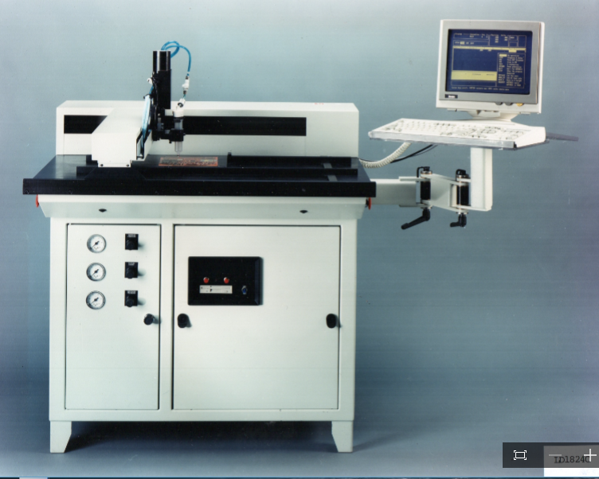
ICON
(photo LD1824}
Notes:
My story: While this was going on --
August 1983: CEO/part owner ICON Corp., Cambridge
Founded 1964, Gordon Baty, Lexington, MIT, process control for the photographic industry. Evolved into a producer of numerical controls and positioning components for the machine tool industry.
1979 to 1983: Industry change: electronics from tubes to chips, recession, machine tool customers fled to Italy
Began making machines. January 1984: first orders for liquid dispenser, LD1824. To apply solder mask.
Iindustry point-to-point. ICON advantage: Continuous contouring
Volume control of masking
Dispensing solder paste

Slide 16
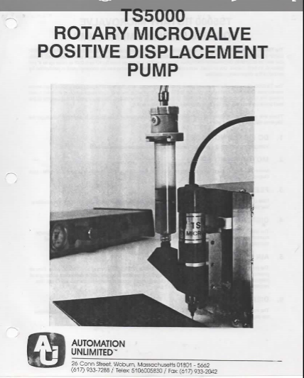
SOLDER PASTE
Notes:
SOLDER PASTE
Solder compacted in valve
Dr. Andrew Kulin, Raytheon Power Tube, MIT Lab
TS5000 valve (photo)
1986: Purchased Automation Unlimited.
ICON: controls, motors and positioning systems
AU: machines

Slide 17
APPLICATIONS
Notes:
APPLICATIONS
1992 NYU Dental, grinding caps to order: integrating the dental imaging with our user ware
Soldermate: Solder filament with Programmable feed, hot iron, note also the change to overhead fixed X axis while the part moves in the Y axis
Hydrogen micro flame

Slide 18
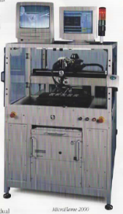
MICRO FLAME
Notes:
First use of open flame heat source.
Start-up Asymtek, Hewlitt-Packard printer technology, low cost, wire drive, point-to-point, self teach.
Dismissed as toy but grabbed market share.
New support frame: X & Y raised over work. Z axis head hangs from X axis. Increases speed and accuracy. In 3D, the next step is to have fixed heads and have the part move on the Z axis. Many features of printer technology.

Slide 19
PROTOTYPING
Notes:
Since the late 1980s, 3D printing has been used to create prototypes and concept models. These can significantly speed and otherwise assist design and pre-production processes, and as a result can save companies a great deal of money as well as improving the function of final products. Material extrusion 3D printers costing a few thousand and even sometimes a few hundred dollars can now make decent prototypes in many situations. More expensive 3D printers based on material jetting or powder bed fusion can now also produce highly detailed, functional prototypes out of a wide range of materials, and increasingly in full color. There is already a 3D printer -- the DragonFly 2020 -- that can 3D print prototype circuit boards.

Slide 20
MOLDS & TOOLING
Notes:
Fastest growing sector * additive manufacture of production tools. *used to cost tens of thousands of dollars*Now produce low-run injection molding masters for hundreds of dollars, and final high-run mold masters for a few thousand.
It is also now possible to directly 3D print sand cast cores and molds * Binder jetting * Traditional sand casting requires wooden patterns * Sand cast molds and cores spare the cost of crafting wooden pattern masters, cast more intricate parts and can cut weeks from production time while saving over 80 per cent.
Lost wax patterns: Material extrusion or vat photopolymerization produce wax-like objects later surrounded by a traditional casting material (such as plaster of Paris) * Mold is heated, wax-substitute melts and is drained away, and molten metal is once again introduced into the mold * Especially popular in jewelry or other small, low-run, intricate metal parts -- and especially as it is now possible to purchase high-resolution vat photopolymerization 3D printers from a few hundred dollars upwards.

Slide 21
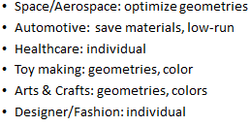
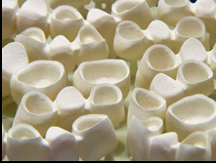
DIRECT DIGITAL MANUFACTURING
Notes:
Space/Aerospace: Space X *Falcon 9 rockets=main oxidizer valve *Crew Dragon capsule=powder bed fusion, engine chambers. Airbus A350 XWB= 1,000 components. GE CFM Leap engine=several parts including some impossible to make conventionally.
Automotive: widely employed to make parts for F1 race cars. Local Motors, LD3M Swim: 75% 3D
Healthcare: Dental, hearing aid shells, prosthetics, living tissue (photo)
Toy Making
Arts& Crafts
Designer/Fashion

Slide 22
MATERIAL SCIENCE
Material/heads: steady progress in heating/curing material; lasers; sintered metals
Polyjet: UV curable materials
Fused Deposition: Strands of Nylon, PC-ISO, PPSF-Polyphenylsulfone, PC-AB,PC-Polycarbonate, ASA, Ultem 1010.
Laser Sintered: Nylon, FR-106, Duraform HST
Direct Metal Laser Sintering: Stainless Steel, Cobalt Chrome, Inconel, Titanium, Aluminum
Wax: Create cavities
Notes:
Serious advances in software, laser fusing of material and medical biology.
Influence of printer technology: Design of heads and chemistry of liquids
PLASTICS
METALS
CERAMIC S
PAPER
BIO MATERIALS
FOOD
CUSTOM BLENDED

Slide 23
SOFTWARE
big progress;
CAD/CAM software
CT/X-ray
Slicing machine
Notes:
http://www.spaceclaim.com/en/Mkting/D2P-2016-MA-SC_Try_It_Now_Landing.aspx Space Claim 0 to 4.0
http://www.spaceclaim.com/en/Mkting/reverse-engineering-video-trial-offer.aspx?utm_source=VAR&utm_campaign=rev-eng-video-2016&utm_
Reverse engineering 0 to 2.0

Slide 24
MANUFACTURING
JET ENGINES
Notes:
Video: GE https://www.youtube.com/watch?v=l0SXlkrmzyw 0 to 5.0

Slide 25
DENTAL

Slide 26
BIOPRINTING
Notes:
Native Human Liver – left
Bioprinted human liver right

Slide 27
MEDICAL
Notes:
http://explainingthefuture.com/video_medical_3dp.html General medical 0.5 to 7.1
https://www.ted.com/talks/anthony_atala_printing_a_human_kidney?language=en kidney 0 to 163

Slide 28
GLOBAL IMPACT
Produce closer to end user
Spare parts on site
Local or household production
Piracy
Medical/Professional services
BFGoodrich

