Slide 1
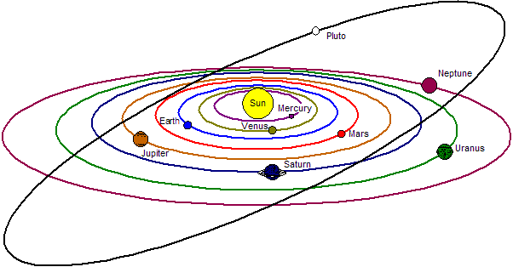
What is going on in our Neighborhood, i.e., Solar System
George Gamota

Slide 2
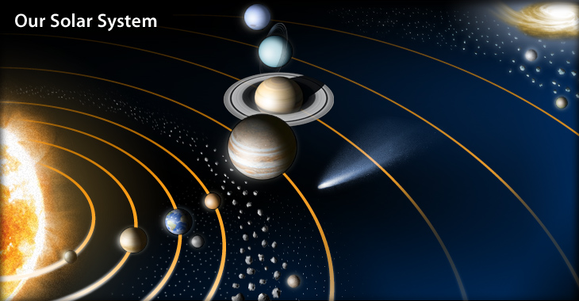
List of Activities
Sun
Mercury
Mars
Ceres
Jupiter
Europa
Titan
Pluto & Charon
Comets & Asteroids

Slide 3
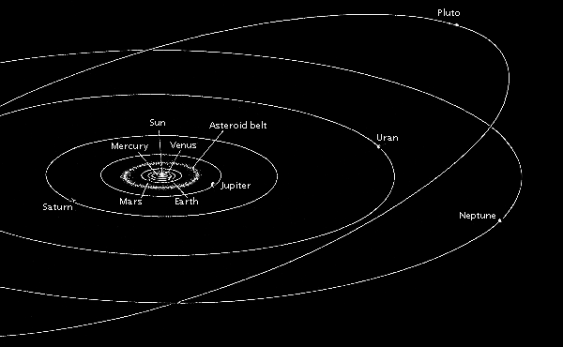
Solar System

Slide 4
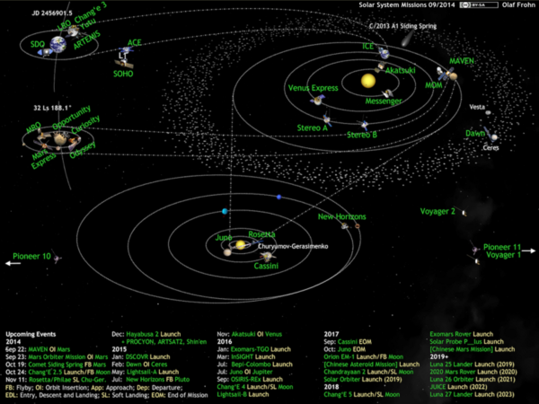
20 Operational Space probes

Slide 5
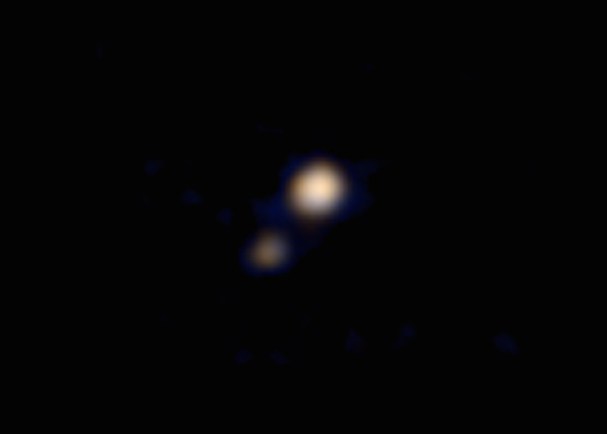
En Route
New Horizons
Juno
Is first spacecraft to study Pluto, Charon and
The Kuiper Belt.
It is the fastest artificially-accelerated object and will be the
Will be fifth probe to leave the solar system
Launched 2006
April 2015
Arrival July 2015
Plutonian orbit takes 248 earth years.
En route to Jupiter
Will enter Polar Orbit
Launched August 2011
Arrival 2016

Slide 6
Missions in Progress
Mangalyaan
2001 Mars Odyssey
First Indian interplanetary probe
Successfully in orbit around Mars
Launched Nov 2013
Arrived September 2014
One of 5 human-made Mars satellites
Acts is relay for Curiosity and Opportunity rovers

Slide 7
Mars Rovers
Opportunity
Curiosity
Launched on July 7th 2003
Landed on Jan 25th 2004
Survived dust storms
Reached Endeavour crater
Launched on Nov 26th 2011
Arrived on Aug 6th 2012
Traveled 10 miles
Close to Mount Sharp

Slide 8
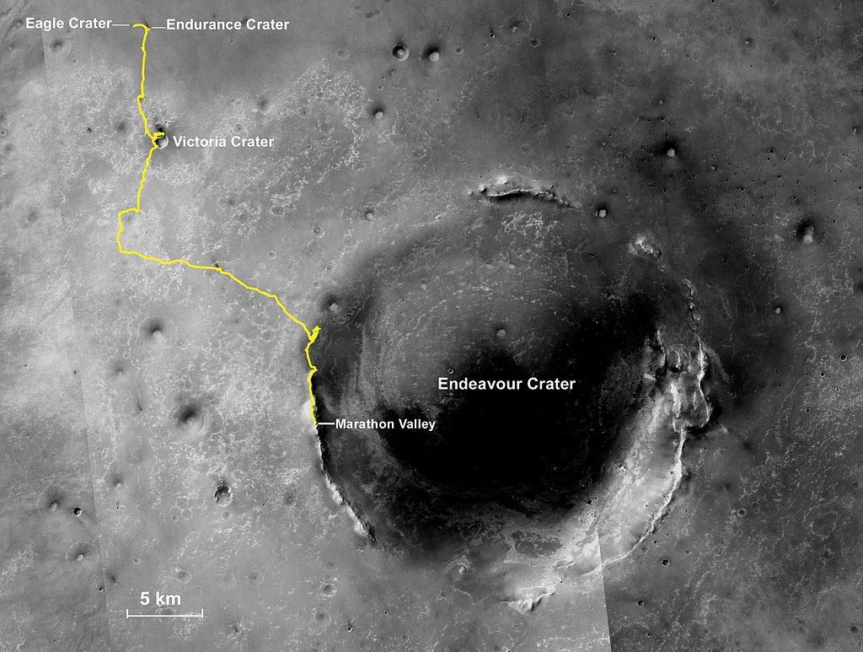
Opportunity

Slide 9
Opportunity

Slide 10
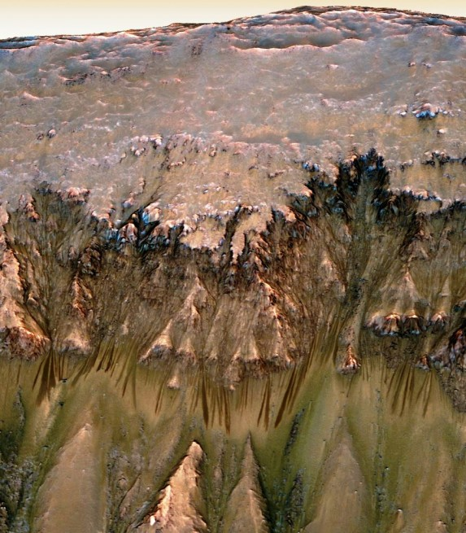
Curiosity
Curiosity
discovered brine
suggesting that there is still
water on the surface of Mars

Slide 11
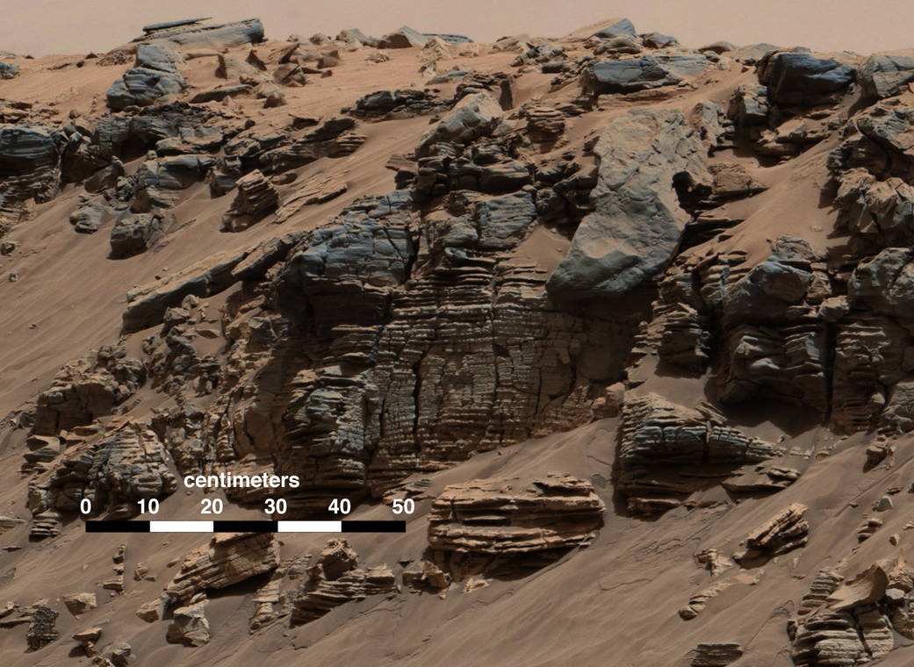

Slide 12
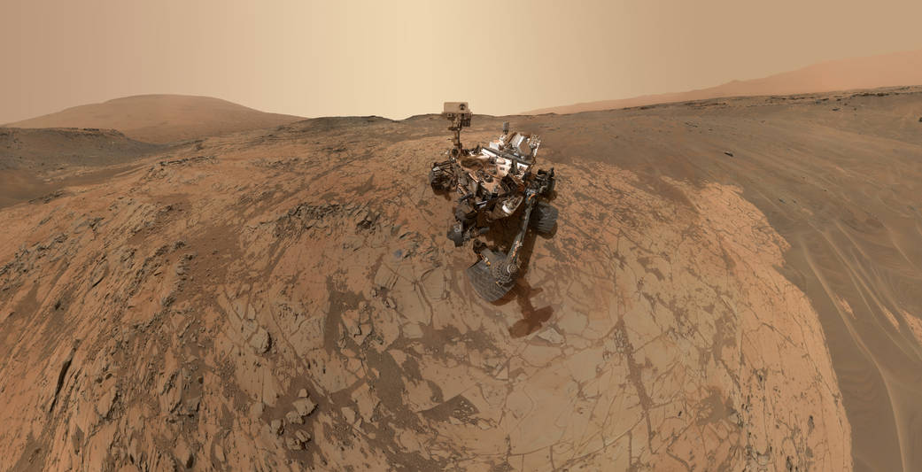
Selfie on Mount Sharp

Slide 13
Missions in Progress - Cassini
Orbiter around Saturn
Launched in 1997
Carried Huygens landing probe to Titan in 2004
Studied Titan’s landscape due to season change

Slide 14
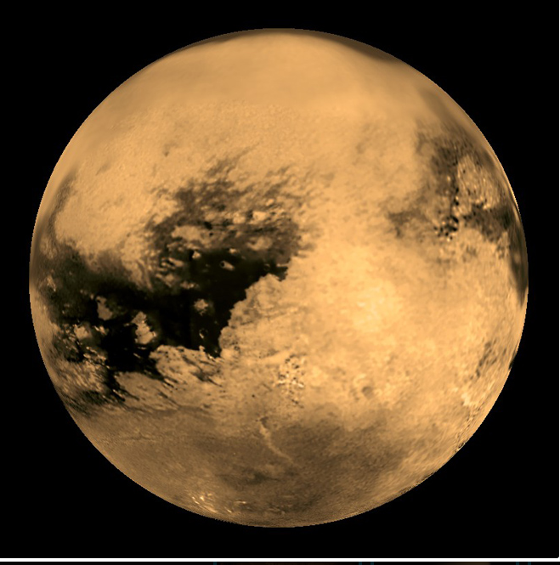
Titan

Slide 15
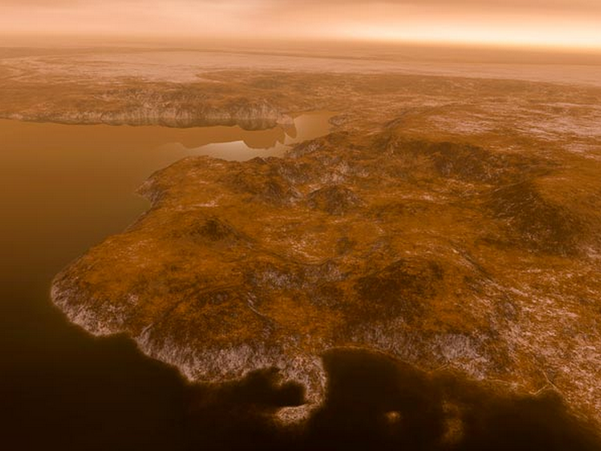

Slide 16
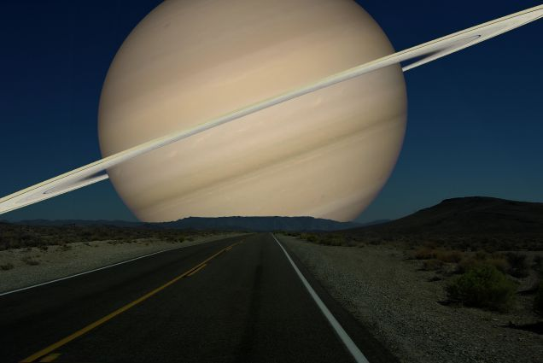
If Earth was Titan

Slide 17
Dawn Mission
Study Ceres and Vesta, the asteroid’s big bodies
Launched September 2007
Arrived on Ceres March 6th 2015
Imaged bright spots on April 14 & 15

Slide 18
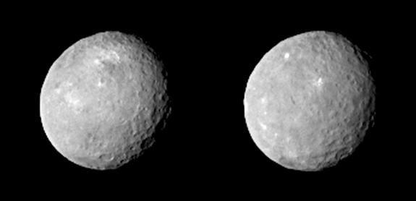
Bright Spots on Ceres

Slide 19
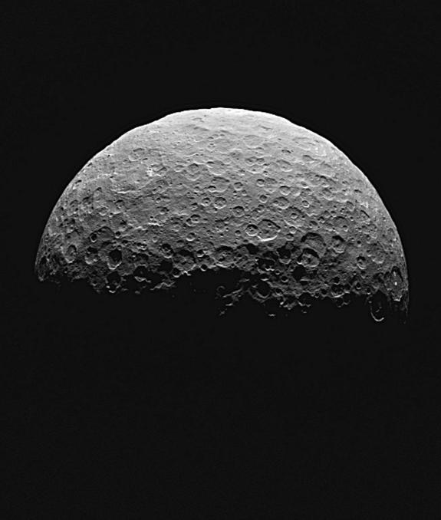

Slide 20
Comets, Asteroids & Meteoroids
What is the difference?
A comet is a relatively small solar system body that orbits the Sun. Comets are made of ice, dust and small rocky particles. When they are close to the sun the ice melts and produces a tail.
Asteroids are small Solar System bodies that orbit the Sun. Made of rock and metal, they can also contain organic compounds
A meteoroid is a small rock or particle of debris in our solar system. They range in size from dust to around 30 feet in diameter (larger objects are usually referred to as asteroids).

Slide 21
Rosetta & Philae
Catching and landing on a comet 67P/Churyumov-Gerasimenko
Launched March 2nd 2004
Arrived November 12th 2014

Slide 22
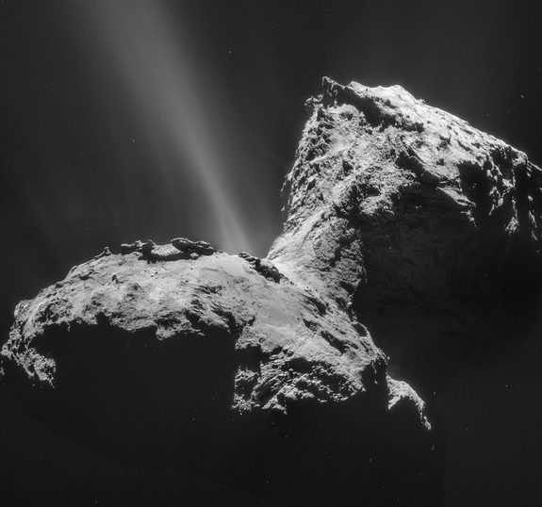
Major jet activity from surface

Slide 24
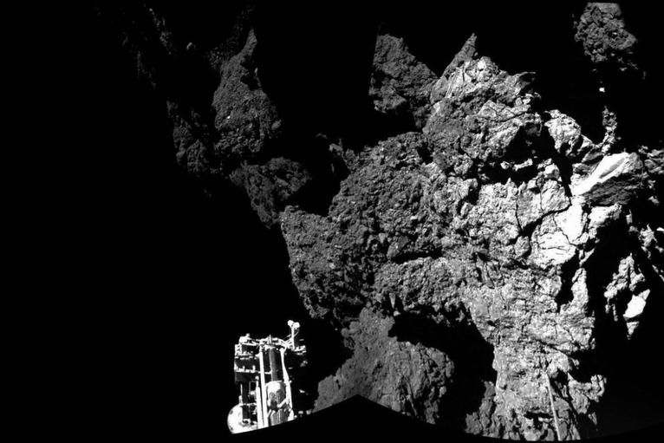

Slide 25
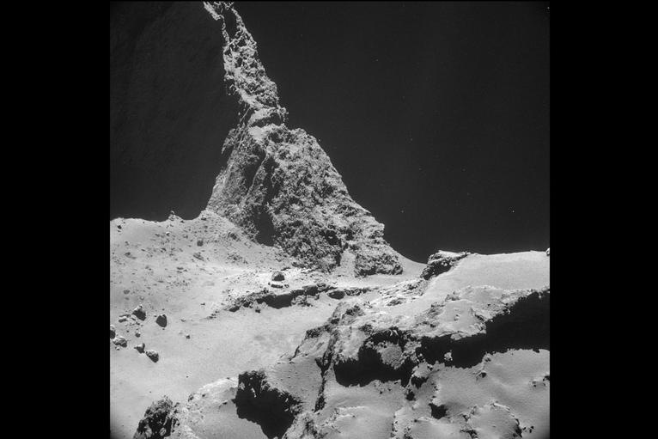
Photo from 6 miles away

Slide 26
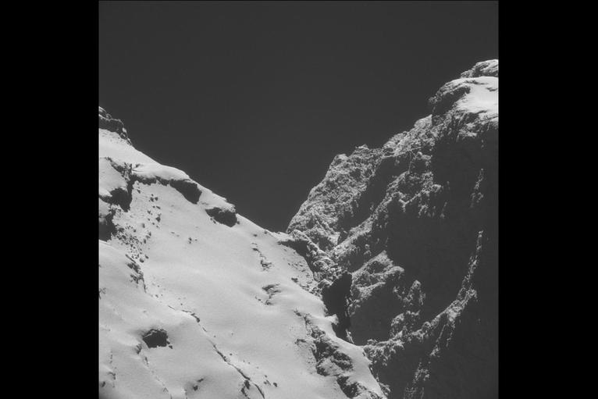

Slide 27
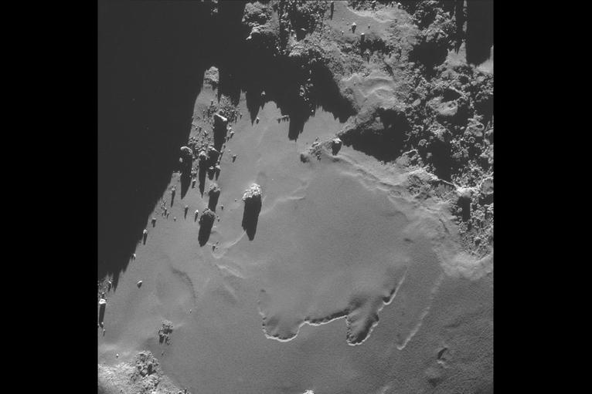
Photo from 5 miles away

Slide 28
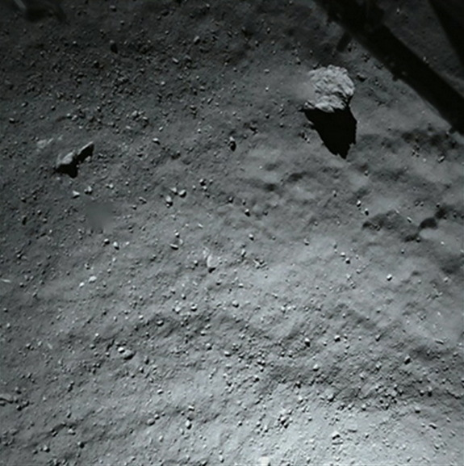
131 feet above ground

Slide 29
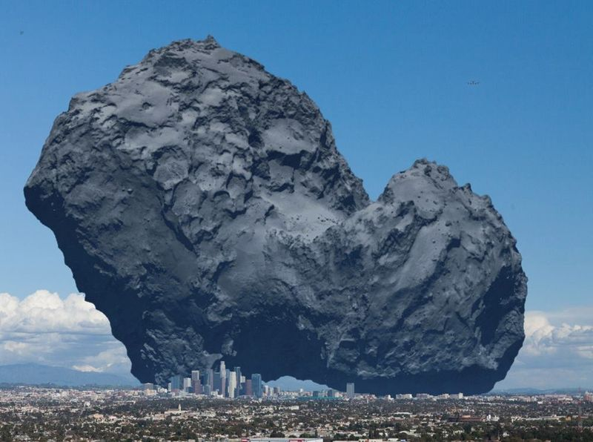

Slide 30
Messenger
Launched August 3rd 2004
Arrived March 2011
Ending life (crash into Mercury) sometime in 2015

Slide 31
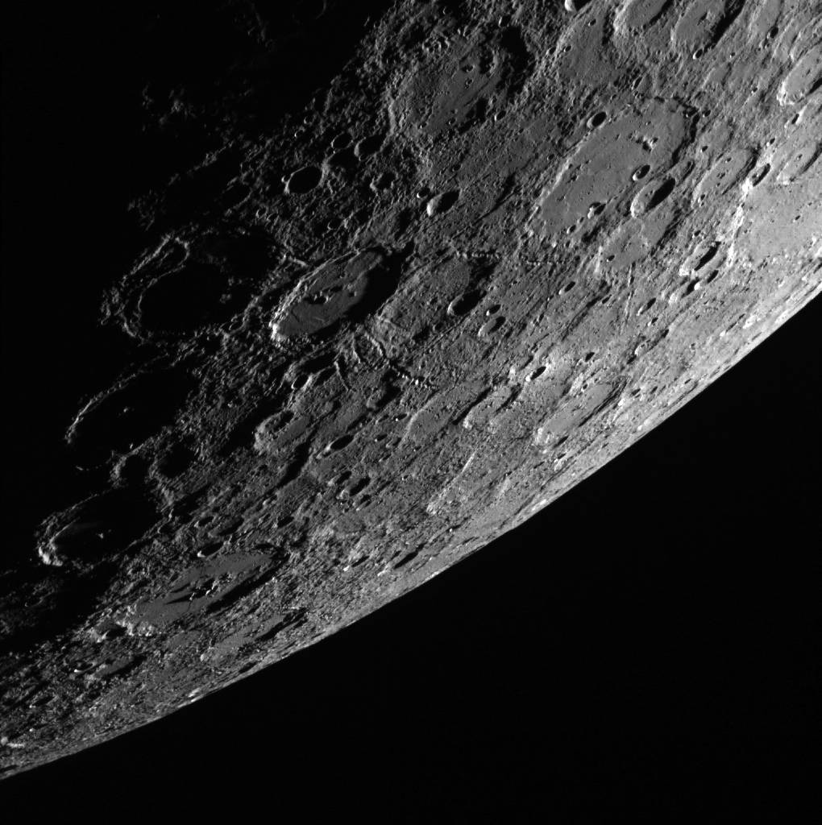

Slide 32
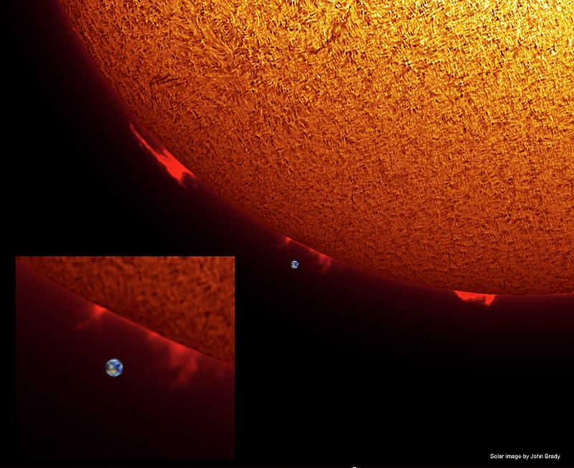

Slide 33
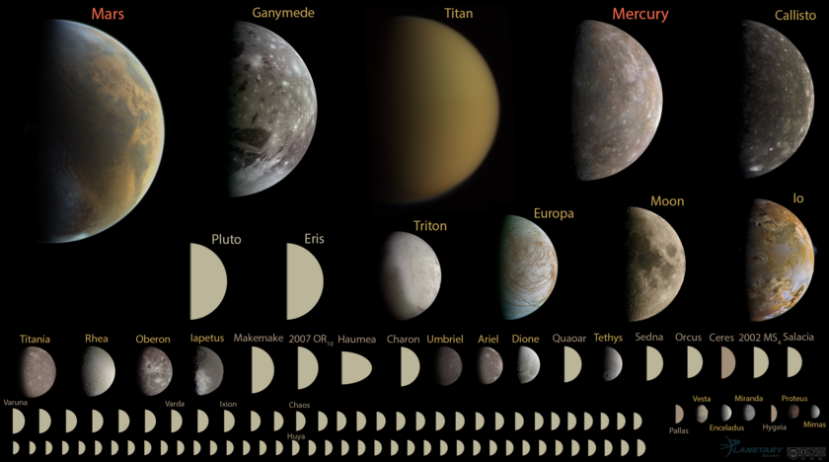
What is Up There?

