Slide 1
RADIATION EXPOSURE
LIMITS AND SAFETY
Talk presented
By
Gerry Sauermann
14 November 2012

Slide 2
OUTLINE
Types of Radiation
Interaction of Radiation with Human Tissue
(X-Rays; Nuclear)
Radiation Measurement
Determination of Radiation Dose (Units)
List of tolerable Exposure Levels
Others
Microwaves (Ovens, Cell Phones)
UV Radiation
Lasers
More Details (Radiation Shielding)
Summary

Slide 3
Types of Radiation
X-Rays (diagnostic and therapy)
CAT/CT Scans
Nuclear Medicine (diagnostic and therapy)
MRI
Microwave (Ovens)
Cell Phones
UV Radiation (Tanning Centers)
Security Scanners
Lasers
Nuclear Background Radiation (Ground and Cosmic))
UV Radiation (Sun)
High Voltage Lines
High Voltage Lines

Slide 4
Radiation Sources can be assessed by Origin
Man Made Sources
Can be turned “ON” and “OFF” as
desired for measured Radiation Doses
( Listed on previous Table in BLACK)
Natural Sources
Radiating 24/7/365;
Radiation cannot be avoided.
(Listed on previous Table in RED)

Slide 5
Radiation Sources can be assessed by Reaction with Matter
Ionizing Radiation
creates and leaves electric charges,
which can destroy or damage cell
structures.
(Listed on previous Table with preceding
marker)
Non - Ionizing Radiation
does not have - or very little - direct interactions
with matter;
absorbed energy is usually converted to heat.

Slide 6
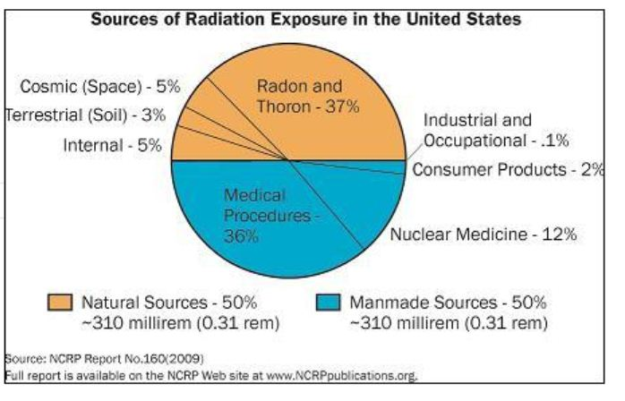
Radiation Exposure
Talk given by
Gerry Sauermann

Slide 7
Interaction of Ionizing Radiation with Human Tissue
In the context of dealing with radiation
effects, Ionizing radiation has to be
considered a continuous stream of particles.
On a statistical basis, the particles interact
with the surrounding tissue,
- causing death of cells outright,
- or damaging the control functions in cells
(leading to cancer),
- or damaging the DNA,
(causing mutations)

Slide 8
X-Rays
Not all X-Rays are created equal !
X-Rays are created with a number of different machines,
producing different interaction-energies, depending on the intended use.
The almost benign ones used for Bone-Density measurements, Dentistry
(low energy)
The middle range used for general diagnostic,
(medium energy), chest X-rays, etc
The top range used for cancer therapy and
X-Ray surgery.(Very high energy)
Note for the interested:
X-Ray energies are usually expressed in Volts,
Ranging from about 40,000 (40 kV) to 10,000,000 (10 MV).

Slide 9
CT/CAT-Scans
CT/CAT Scans can be considered being
sequences of large numbers of individual
X-Ray images taken in rapid succession.
These images are combined by very complex computer
calculations which result in three-dimensional
rendering of the objects examined.
CT/CAT Scans require substantial amounts of
X-Ray imaging and therefor substantial radiation
exposures!

Slide 10
Nuclear Radiation BACKGROUND RADIATION
“Nuclear Radiation” is a term covering a large number of different types of radiations and sources
Background radiation emanating from Uranium and Thorium enclosed in granite rocks, resulting in the release of Radon into the atmosphere and ground water.
Background radiation from all organic matter mostly due to radioactive isotopes of Carbon, Oxygen and Potassium
Background radiation from power plants
Both nuclear AND coal-burning plants
Background radiation from cosmic rays interacting with
molecules in the atmosphere, causing “Showers”

Slide 11
Nuclear Radiation (Cont.) Medical Applications
Uses in diagnostics:
Use of various isotopes of elements with
affinities to specific organs to be examined.
Generally administered internally.
Radioactive probes usually have very short
“Half-lives” for reducing the radiation exposure of
patients.
Uses in therapy:
Uses of powerful radio-isotopes either applied
internally or externally for destroying tumors.
Very heavy radiation exposure determined by risk assessment

Slide 12
Radiation Measurements
Amount of exposure directly related to radiation level
Originally made with film strips.
Modern radiometers measure created charge.
For detection of low level nuclear radiation
Geiger counters and related instruments.
For high level nuclear radiation modern
solid state devices.(Dosimeters)

Slide 13
The Radiation Dose
The parameter of evaluating radiation exposures is the
“Radiation Dose”.
The “Dose” is actually the product of
absorbed radiation x time of exposure.
To simplify the measurements dosimeters
actually display the readings in dose per a
given time (per second, or minute, or year, etc)
Presently there are two units in use for defining the absorbed
radiation:
The “rem” and the “Sievert (Sv)”
Both define the same thing, but differ by a factor of 100
1 Sv = 100 rem
The importance of these two units has to be known
when evaluating exposure charts.

Slide 14
Radiation Exposure
Talk given by
Gerry Sauermann

Slide 15
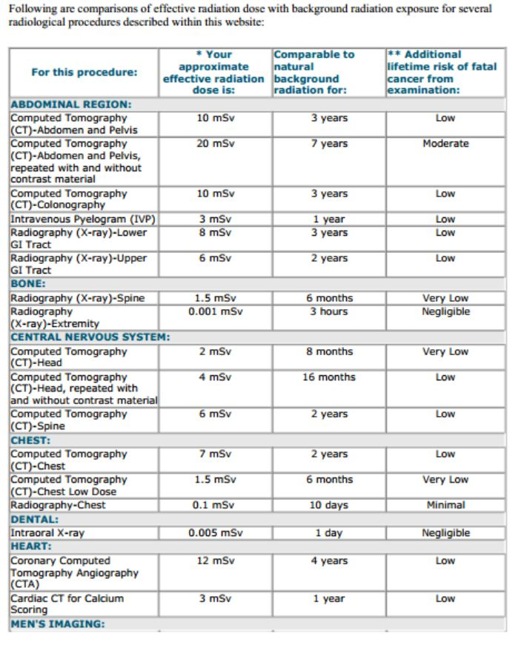
RADIATION EXPOSURE LEVELS FOR VARIUS MEDICAL PROCEDURES

Slide 16
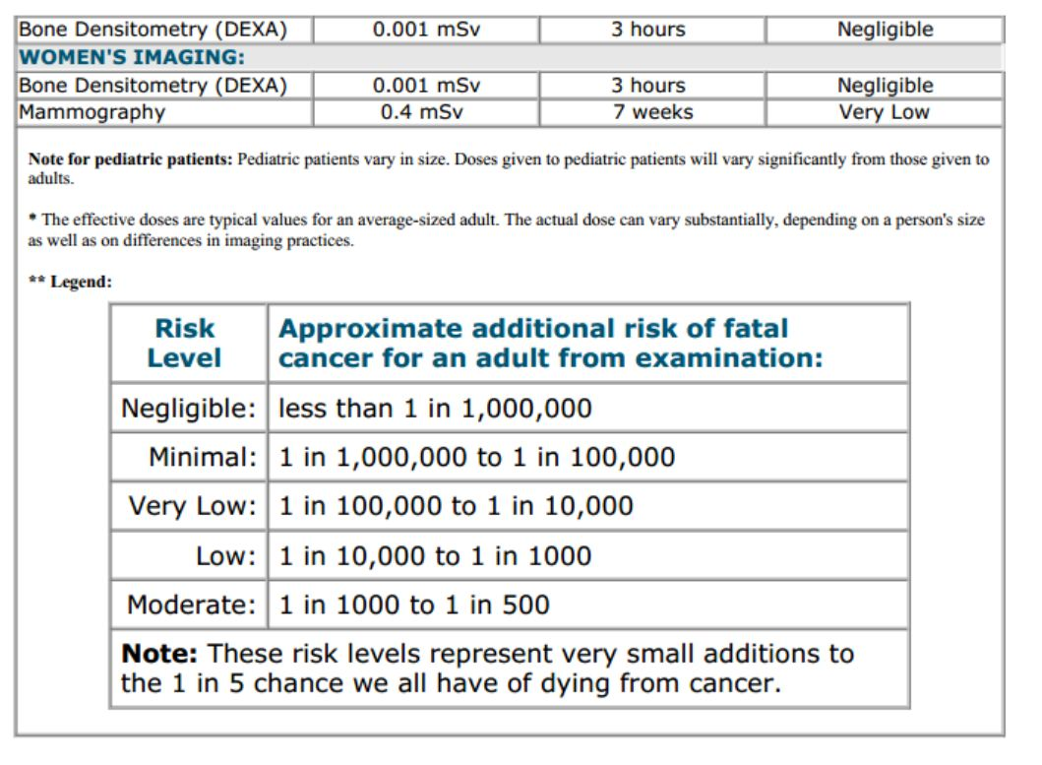

Slide 17
Non-Ionizing Radiation
Defined as Radiation not energetic enough to create electrical Charges in Matter
Major Candidates:
* Microwaves (Cell Phones, Ovens, MRI,
Radar)
*UV Radiation
* Lasers (Laser Pointers)

Slide 18
Cell Phones
Considerable confusion exists concerning safety
(as can be seen on the Internet).
All reputable engineering and science organizations so far could not find any credible connection between the use of cell phones and cancer!
But since science cannot declare with 100%
confidence something does not exist,
scientists concede that there may a be a remote
possibility of finding connections in the future

Slide 19
Cell Phones (Cont)
The radiated power emitted by cell phones is regulated and closely watched by the US Government.
The accepted radiation limit is defined by the energy absorbed by the head.
The unit used is called SAR
(Standard Absorption Rate) measured in W/Kg.
No cell phones can exceed a SAR Value of 1.6.
SAR values for dozens of phones are listed on the internet – most phones are below 1.0

Slide 20
Problems connected with Cell Phones
Most serious: Talking while driving.
Radiation from relay towers
Placement of relay towers
Long and extended, continuous calls.
(substantial heat may be created next to the head)

Slide 21
Microwave Ovens
Microwave ovens create a substantial amount
of microwave power (Up to 1 to several KW).
Note:
The frequency of the microwave radiation is set
to coincide with strong absorption by water.
All the radiated energy is deposited and turned into heat,
which cooks the food from the inside.
Proof:
All dry materials, such as paper plates and dishes stay cool
(and if they warm up it is by heat transfer from the food).
If there is any metal in the oven, it will heat up dangerously fast!
Watch out for gold plated decorations (edges, etc), they may heat up and crack the dish.

Slide 22
Possible Problems with Microwave Ovens
All microwave ovens have been designed to be safe for human beings, provided they are well maintained!
Escaping radiation from defective devices will be felt as heat. Different from normal ovens which heat by conductance, the microwaves can, to some extend, penetrate into the body, heat it from the inside and cause injuries.
It is of great importance that the doors shut closely,
and that the hinges are functioning properly!
The most important point is that the metal screen in the door has to be fully in tact, any additional holes can present a danger.
But, by following the above precautions, there is no reason
whatsoever, not to greatly enjoy your Microwave Oven !

Slide 23
MRI Scans
MRI Scans use a combination of very strong magnetic fields and high frequency radiation.
The exposure levels are tightly controlled,
similar to those for cellphones.
The high magnetic fields may cause effects unrelated to the radiation, by moving imbedded metal parts, such as shrapnels or some types of implants.

Slide 24
Radars
Health questions concerning the vicinity of air traffic control and military RADAR stations
Police RADARS, concerns for operators and illuminated traffic
Radars on boat, placement of antennas
Effects of radar illumination are basically heating of tissue.

Slide 25
Ultra-Violet Radiation
Strong correlation between UV radiation exposure and skin cancer.
Distinction has to be made between
“A”, “B” and “C” type UV.
UV A relative benign (Black Light)
UV B causes suntan (at moderation)
UV C dangerous, used as Germicidal agent
Complicated relation between absorbed radiation and actual heat burns.
Use of UV screens important
Use of sun glasses highly recommended
Regular glass windows provide some shielding

Slide 26
Lasers
Distinction has to made between LED’s
( light emitting diodes) and actual lasers
LED’s are basically benign, but now available
high power devices have to be treated similar
to high watt light bulbs (eye damage)
Lasers, even small pointers, can cause severe eye damage due to their high energy concentration.
Special precautions have to be taken when devices such as DVD players are taken apart.
General Rule: Never point lasers toward people,
Never look directly into the beam!

Slide 27
Summary
We live in a dangerous world exposed to a large variety of hazards.
Many of these hazards can be effectively contained not to becoming dangers.
Obtaining accurate information is the best personal protection for all of us.
Beware of all the un-scientific publications,
which are usually aimed only at selling expensive
products
Remember that all necessary radiation exposures
have to be seen in the light of “Risk Assessment”!

