Slide 1
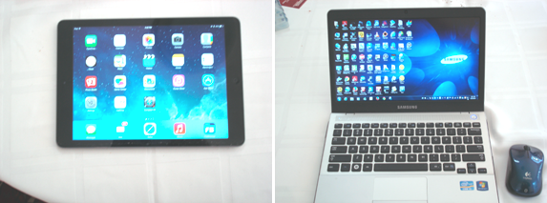
iPad / PC Integration:
Two Different machines

Slide 2
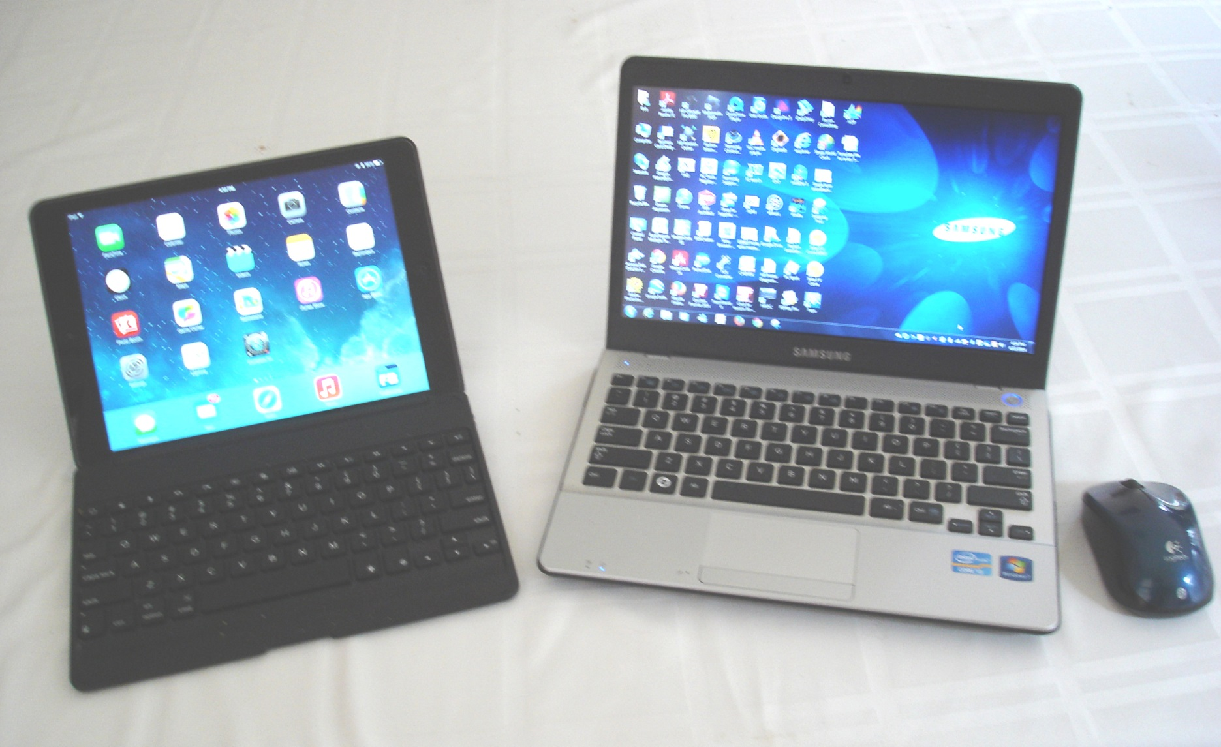
iPad / PC Integration:
How to make them play and work well together

Slide 3
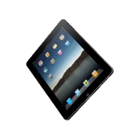
Happy Together!

Slide 4
Topics
External Bluetooth Keyboard
Presentations / desktop duplication
Office applications
Microsoft Office
iWork
Communication / file transfer
Printing
Remote desktop applications
Email enhancement
Network analysis
Other

Slide 5
This presentation is being streamed from iPad to the PC and HDTV
AirServer ($14.99) is PC software that allows the screen of an iPad / iPhone to be cloned to a PC
http://www.airserver.com/
Anything on iPad / iPhone screen is seen on PC
Since the HDTV in this meeting room is connected to the PC via an HDMI cable, the iPad screen is seen on the HDTV

Slide 6
This presentation is being done with PowerPoint on the iPad
Microsoft recently announced Office for the iPad (Word, Excel and PowerPoint)
It is part of the Office 365 subscription deal:
($99.99 / year for installation on 5 PC’s or
Mac’s AND 5 tablets or iPads)
Includes Microsoft OneDrive access (PC, Mac, iPad, iPhone)
Cross platform compatibility good EXCEPT: NO Macros

Slide 7
A way to run Excel Macros
OnLive desktop
It is a virtual PC running in the cloud
Requires a FAST Internet connection
Demo

Slide 8
How to run any program on a PC from your iPad
Microsoft Remote Desktop (free)
Simple to set up
Allows the running of any PC program on the remote client
CAUTION: Connecting to the RD client will interrupt any local session on the client PC
DEMO after meeting if interested

Slide 9
iPad Mail: Distribution Lists
Capability not in native iPad mail App
Suggest MailShot ($3.99 at App Sore)
Demo

Slide 10
iWork
Free alternative from Apple available on the App Store: iWork
Pages (Word alternative)
Numbers (Excel alternative)
Keynote (Powerpoint alternative)

Slide 11
How to get files back and forth between iPad and PC
iTunes (cumbersome)
There are many apps that purport to easily transfer files back and forth over Wi-Fi. I have tried several, and most either don’t work or have limitations
One that works is FileBrowser

Slide 12
File Browser
http://www.stratospherix.com/products/filebrowser/
Purchase on the App store for $7.49
I regard this app as essential:
Access to all network shares: PC, Mac, NAS, WiFi hard drives, including over VPN
Note VPN limitation of iOS: IP conflict can be an issue
Can access Microsoft One Drive (default location for Office 365 file saves); a way to put files wherever on the network you want them
(Demo)

Slide 13
Printing
Easiest: ePrint enabled printer
e.g. HP OfficeJet Pro 8600
http://www.hp.com/united-states/campaigns/mobility/
If you don’t have a ePrint enabled printer
Use PrinterPro
App for iPhone / iPad ($6.99)
Helper application on PC works with any printer

Slide 14
Very Useful Networking Tool
NetAnalyzer
Very quick way to view all devices on network, PC’s, Mac’s, iPhones, iPads, routers, network switches, and Internet connected HDTV’s complete with IP adresses
https://itunes.apple.com/us/app/network-analyzer-ping-traceroute/id557405467?mt=8
$2.99 on iTunes
Demo

Slide 15
Other
Banking apps
Quicken 2014 (no access to brokerage accounts on iPad)
Encryption Utility
Axcrypt (free, available for PC and iPhone / iPad. In combination with FileBrowser constitutes a secure locally stored password and encrypted file management utility
http://www.axantum.com/axcrypt/
See Apple App store for iPad / iPhone version of Axcrypt
WiFi camera utilities, e.g. Nikon WMU

Slide 16
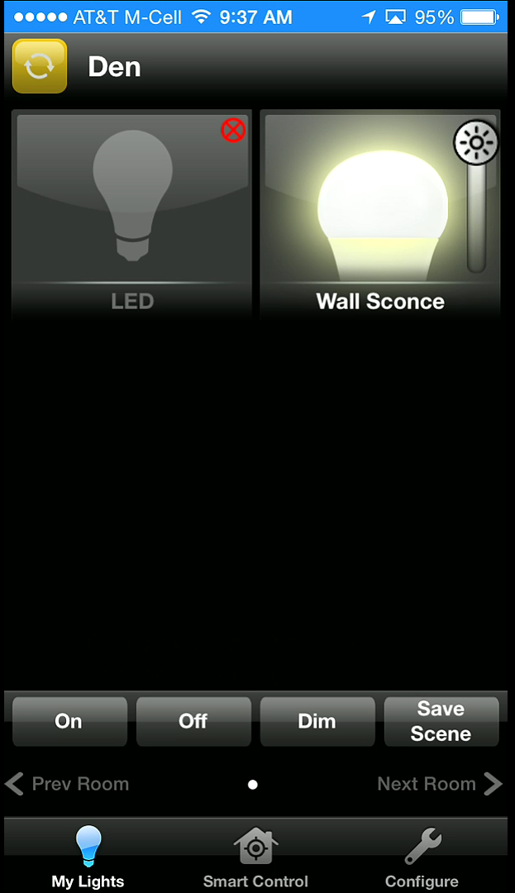
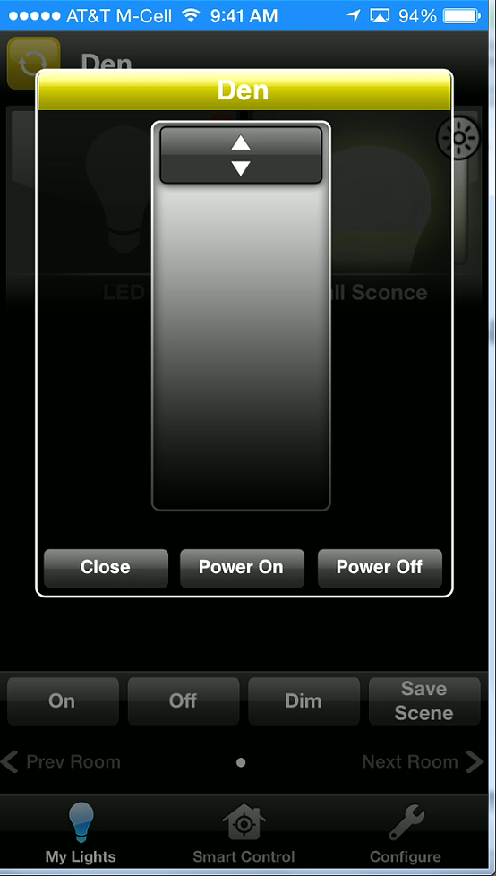
Other
Smart lighting Apps (also can control from PC)
TCP lighting
60 W equivalent, 2700° K color temperature

Slide 17
Additional Reading
Pc Magazine article on iPads in the office:
http://www.pcmag.com/article2/0,2817,2412180,00.asp
How the iPad 2 Became My Favorite Computer by Harry McCracken:
http://technologizer.com/2011/12/05/how-the-ipad-2-became-my-favorite-computer/
An analysis of iPad and PC in business and academia:
http://www.joachim-scholz.com/academipad/2012/04/23/ipad-or-laptop/
Transform Your iPad Into a Computer with Unique Applications
http://www.youtube.com/watch?v=OQd3yKpYdyg

Slide 18
Copies of this Presentation
https://groups.yahoo.com/neo/groups/LexingtonComputerGroup/files/2014%20Presentations/
https://www.copy.com/s/kM9ihnvoaVQcDmw1/Presentations

Slide 19
Discussion:
What are your top 10 Apps?

