Slide 1
What is Bluetooth?
Bluetooth is a proprietary open wireless technology standard for exchanging data over short distances (using short wavelength radio transmissions in the ISM band from 2400-2480 MHz) from fixed and mobile devices.
(info from ask.com)

Slide 2
What is Bluetooth good for?
Wireless mouse / keyboard
Wireless data transfer to / from cell phones (alternative to USB or emailing files
Wireless headsets connected to cell phones / PC
Wireless cycling computers speed / cadence / heart rate data transfer
Audio streaming from PC / iPods to wireless speakers / stereo receivers
etc., etc.

Slide 3
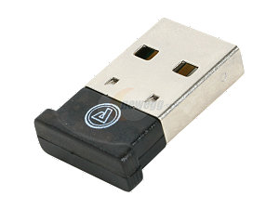
Bluetooth
Either built into many laptops, or
Add with inexpensive Bluetooth dongle
Example:
AZiO BTD211 Micro Bluetooth Adapter USB 2.0 ($9.99 at Newegg)
http://www.newegg.com/Product/Product.aspx?Item=N82E16833340019&Tpk=33-340-019

Slide 4
Using Bluetooth
When Bluetooth is installed, either built-in or with a Bluetooth dongle, Bluetooth icon shows in system tray
Many devices require no additional software; an example follows

Slide 5
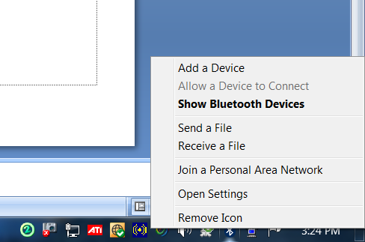
Right click on Bluetooth icon
Click on

Slide 6
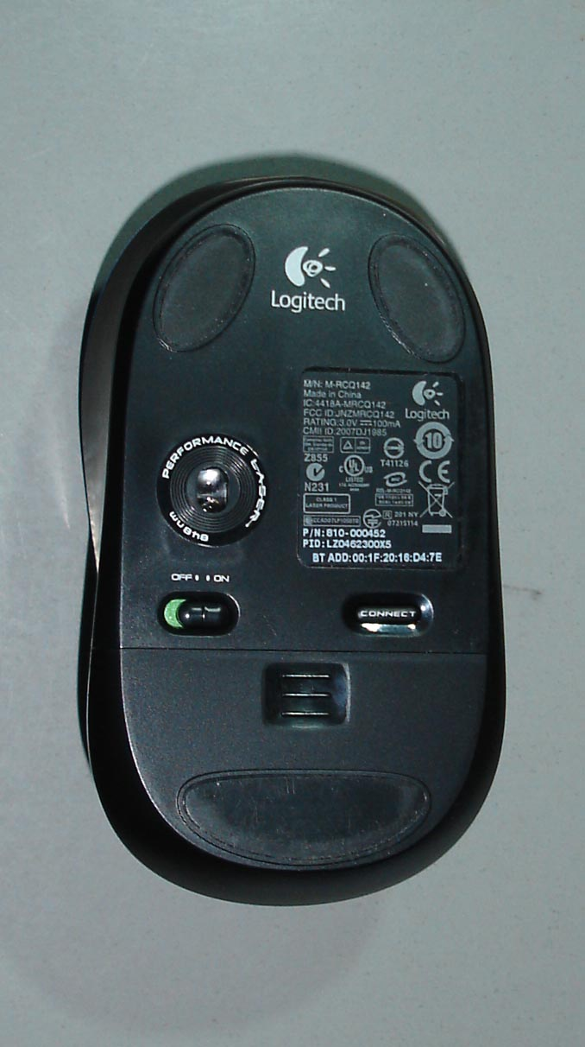
How to make discoverable: example using Logitech Bluetooth mouse
“CONNECT” button; push

Slide 7
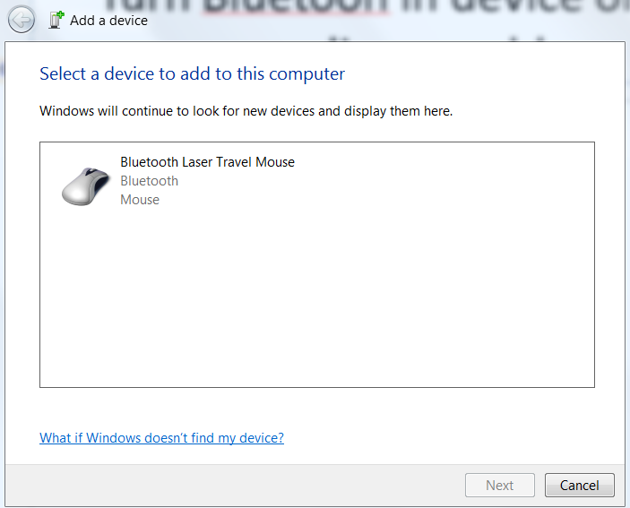
Turn Bluetooth in device on; make discoverable
Select device to add; click Next

Slide 8
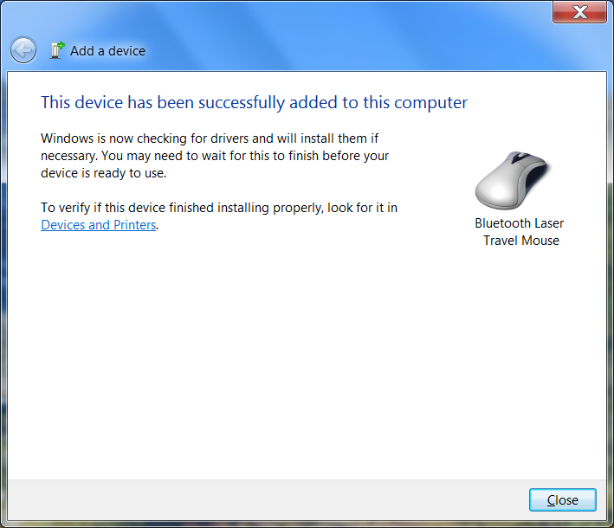
Result:
Device works!

Slide 9
Example of device that requires security code to connect and special software from Device manufacturer
My Sony Z790a cell phone
Requires Sony Ericsson PC Suite 6.0 to:
Synch contacts with Outlook
Two way file transfer
Live DEMO follows

