Slide 1
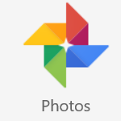
Google Photos One home for all your photos/videos – organized and easy to find
George Gamota
October 12 2016

Slide 2
Google Photos
What is it?
How do I get it?
Scanning for photos
Albums
Searches (face recognition), dates & sites
Sharing
Storing
Privacy

Slide 3
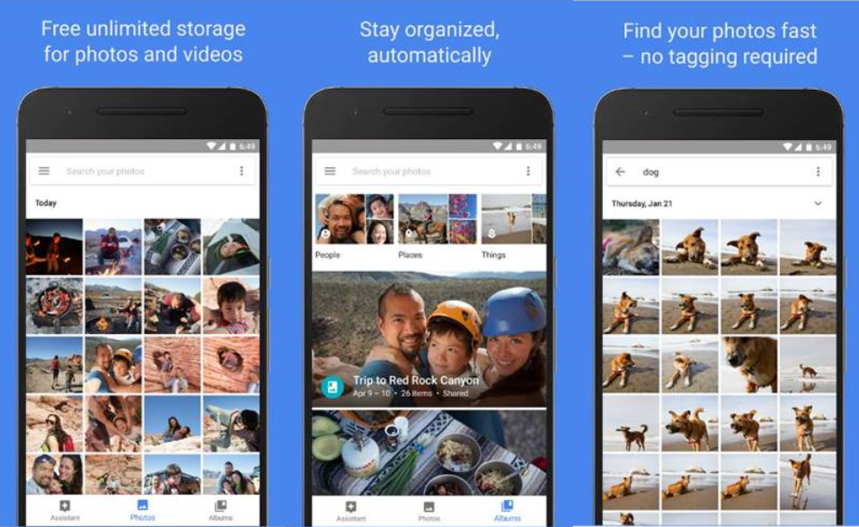
Google Photos

Slide 4
What is Google Photos (1)
Google Photos is a photo and video sharing and storage service by Google. Its core features were previously embedded within Google+ & it replaces Picasa
The new Google Photos includes FREE unlimited photo and video storage for photos up to 16 megapixels and videos up to 1080p resolution (the maximum resolutions for average smartphone users in 2015
Will store photos/videos at higher resolution for a fee, once you exceed 15 Gigs of memory
Offers apps for the Android, iOS & Microsoft operating systems, and a website.
Picks up photos from ALL devices: Smartphones, digital cameras with Wi-Fi, PC’s and Apple. It searches all folders and files having photos

Slide 5
What is Google Photos (2)
Service will back up all photos to the cloud, which becomes accessible between all of their devices connected to the service.
Photos/videos are synched across all platforms.
Google Photos has:
Editing Tool
Sharing service
Search capability (by images, words, dates etc.)
Creation of Albums with auto or manual sorting capability

Slide 6
What is Google Photos (3)
The Photos service analyzes and organizes images into groups and can identify features such as beaches, skylines, or "snowstorms in Boston”
From the application's search window, users are shown potential searches for groups of photos in three major categories:
People
Groups faces as they age
Places
The Places category uses geotagging data but can also determine locations in older pictures by analyzing for major landmarks
Things
Google is a search engine, so search with key words

Slide 7
How do I get Google Photos?
Search for “Google Photos” on your PC

Slide 8
How do I get Google Photos?
On Android devices go to “Google Play”
ON Apple devices go to iTunes

Slide 9
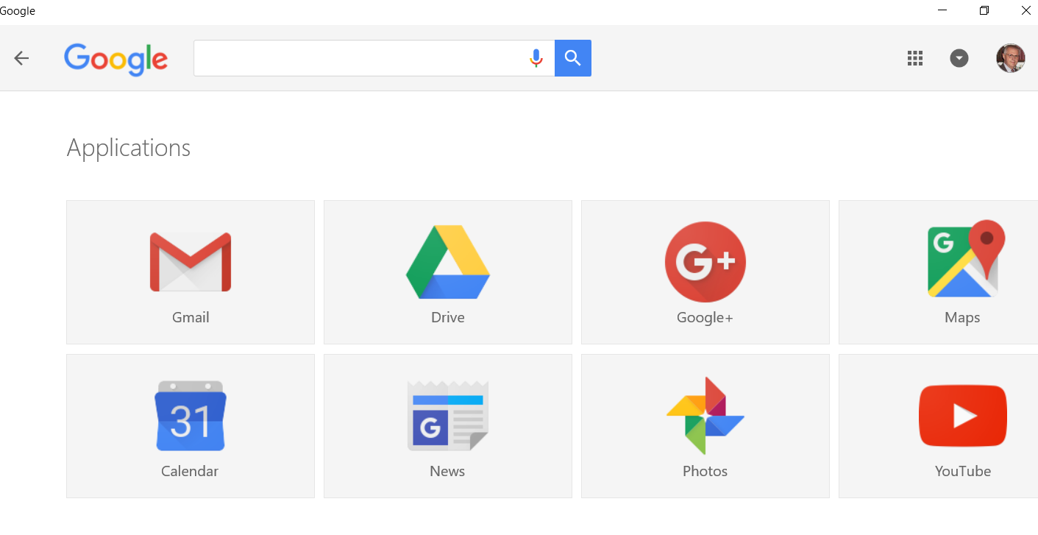
My Google Desktop

Slide 10
How do I get Google Photos?
Go to Google.com
Sign in with your Google account
If you don’t have an account, create one & sign in
Worried about security, make up a fictitious person (you also need to create a Gmail account with that fictitious name)
You can manually upload your photos
Time consuming & potentially you might miss some!
Set to “Desktop Uploader”
With this option, Google Photos scans your whole computer for photos/videos
You can manually delete photos once they download
To download photos from emails, need to identify the folder holding your emails, messages, Instagram and all non-Google products.

Slide 11
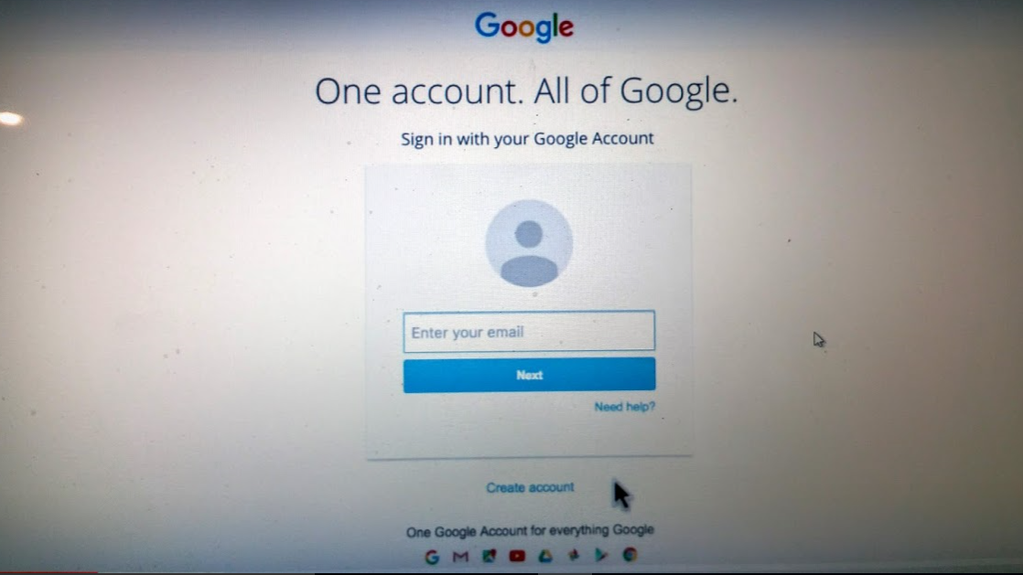
Google Account

Slide 12
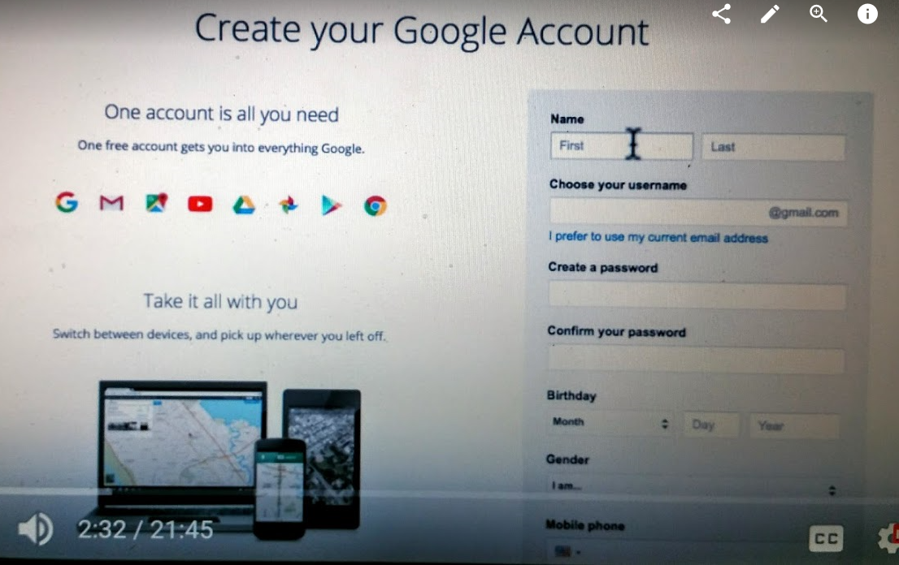

Slide 13
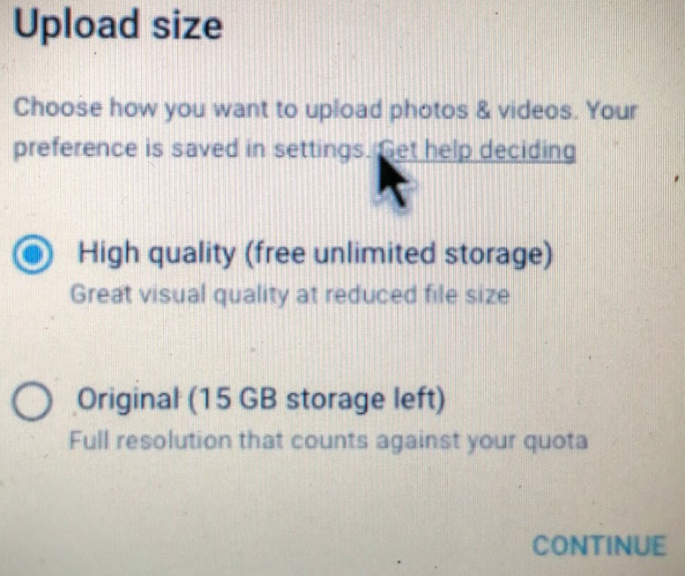
Settings
Upload only when connected to Wi-Fi and/or charging

Slide 14
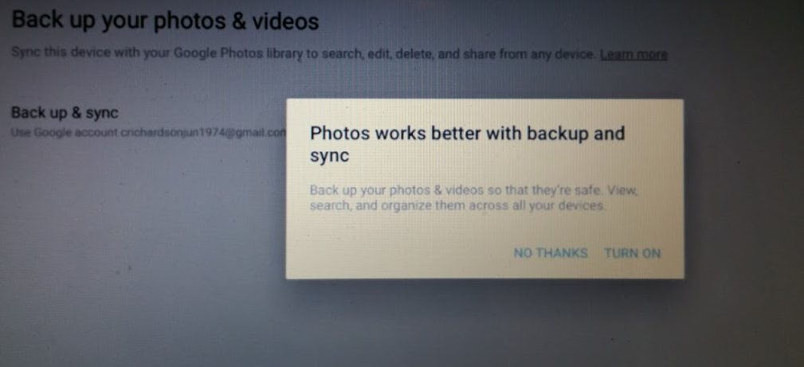
Backup Options

Slide 15
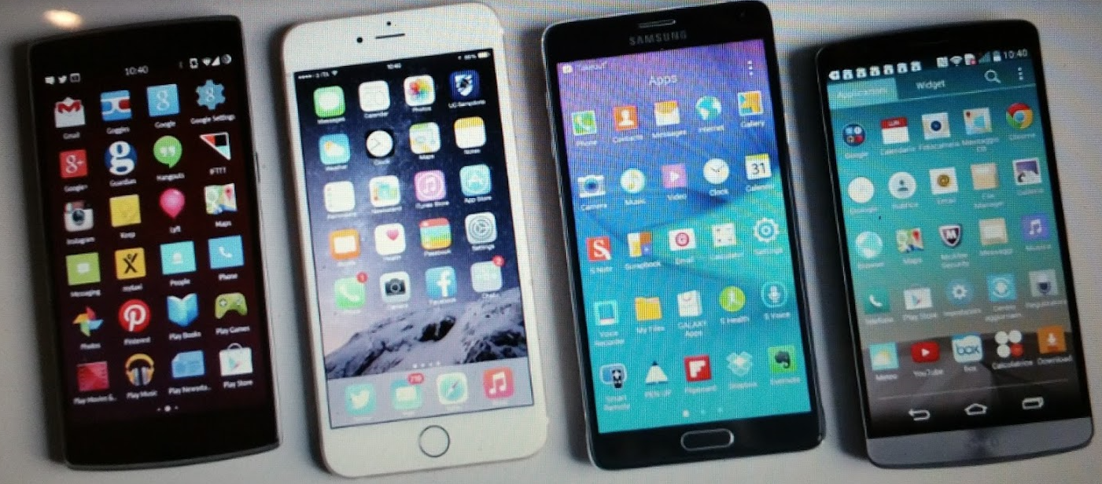
How do I get Google Photos?
Now go to your other devices, & download Google Photos app’s
Sign in to your Google account

Slide 16
Searching
Google Photos will automatically arrange your uploaded pictures by location and by date taken
At the bottom right, touch the search icon and from the box, type what you want to find–like food, cars, or your pet and touch “Enter” or “Search.”

Slide 17
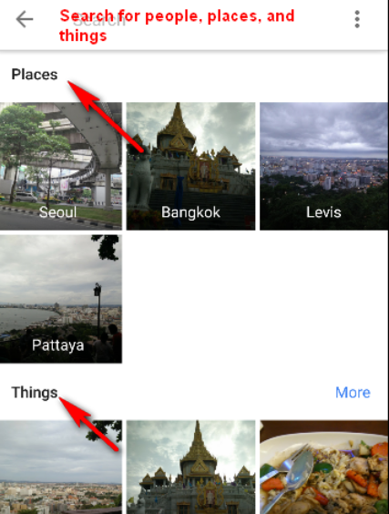
Searching

Slide 18
Grouping
You can group similar faces/locations/events together and label them: e.g., Paris, Uncle Joe or trees
Google creates models of the faces in your photos so you can group them together.
Face groups and labels are PRIVATE and will not appear to anyone you share photos with.
To create a label for a face group, tap “who is this?” at top of face of a face group.

Slide 19
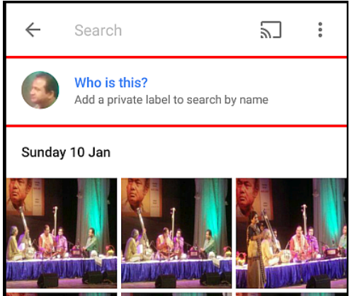
Grouping
You can change/edit or remove the name label

Slide 20
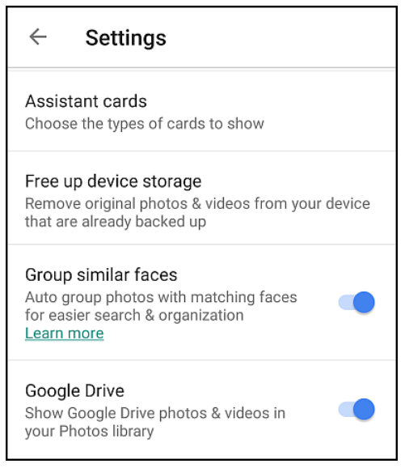
Settings (1)

Slide 21
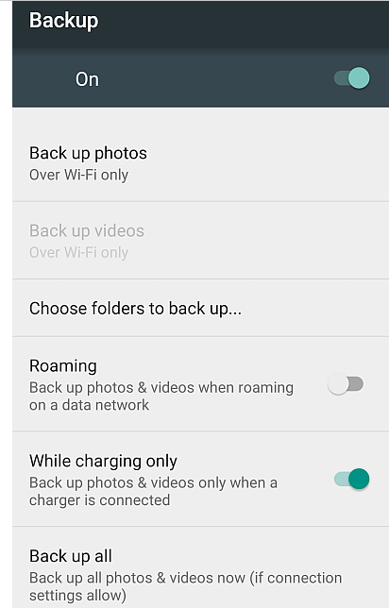
Settings (2)
Back up photos over Wi-Fi and/or Cell provider if you have unlimited data plan
Backup only when charging. Taking photos & especially videos and sending them takes battery life.

Slide 22
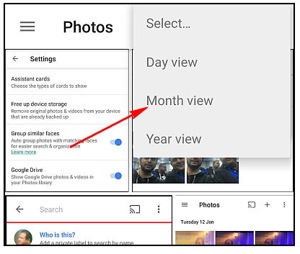
Settings (3)
You can change “view”
Select Multiple photos with single TAP
Long-press (or shift key on computer) on any photo & without lifting finger move to other photos you want to select.
You can also undelete photos from trash during session. Once you sign out, trash is emptied

Slide 23
Inter-app compatibility
Except for Google Drive, NONE

Slide 24
Sharing
Recipients of shared images can view web galleries without needing to download the Google Photos app
If someone shares his/her photos/videos etc, and you download them on your computer, then those photos will be automatically saved on your Google Photos – very useful and saves time and money.

Slide 25
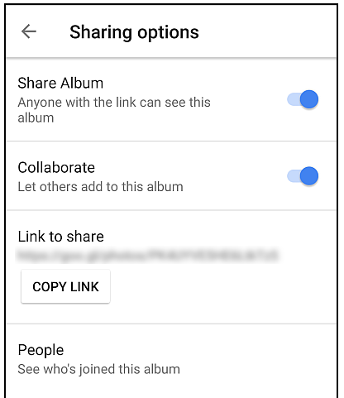
Sharing
Sharing on PC

Slide 26
Creating
Albums
Stories
Animations
Collages
Shared albums allow receiver to add photos with your permission (can become a group, family activity)
Possesses editing tools – color, brightness, rotate, crop etc.

Slide 27
Privacy
Google uses identity, location, time and date
Google promises that my family pictures won’t show up in Google image searches without my permission.
On the other hand, if one of my photos gets posted on a website, blog or social network, it’s fair game.
Share only with people you trust.

Slide 28
Two Sample Tutorials
https://www.youtube.com/watch?v=IEJH0n6xuJk
https://www.youtube.com/watch?v=R5y9Z92NpiY

