Slide 1
Editing the Registry: REGEDIT
Warning, WARNING, WARNING!!!
Modifying or deleting the wrong key can render your computer unbootable!
Turning it into a BRICK!

Slide 2
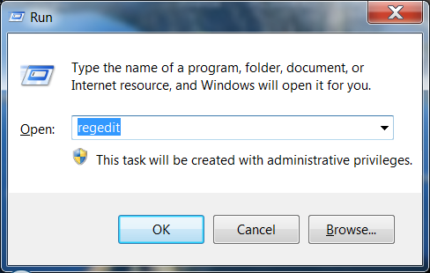
REGEDIT: rename Outlook profiles
The only way to rename an Outlook profile is through editing the registry
Start REGEDIT by Start menu, run

Slide 3
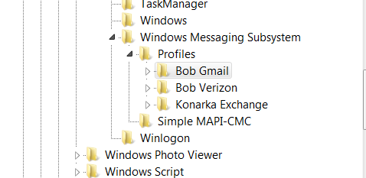
Navigate to the key that you need to change:
HKEY_CURRENT_USER\Software\Microsoft\Windows NT\CurrentVersion\Windows Messaging Subsystem\Profiles\
Right click on the profile that you want to change and select rename

